Slide 1


Slide 2


Part 1: Introduction
Food Safety Compliance
HACCP introduction
Methodology
    Prerequisite program
    Control measures
HACCP study: specific hazards
HACCP study: decision tree, raw materials and processes
Our company: HACCP
Legislation
    EU regulations & Information sheets & Recall
    Food Safety Authority
Notes:
2

Slide 3
Introduction
Food Safety Compliance
HACCP introduction
Methodology
    Prerequisite program
    Control measures
HACCP study: specific hazards
HACCP study: decision tree, raw materials and processes
Our company: HACCP
Legislation
    EU regulations & Information sheets & Recall
    Food Safety Authority
Notes:
3

Slide 4
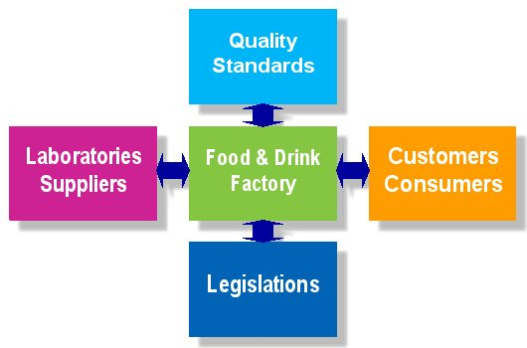
In which field do we operate?
Notes:
4

Slide 5
Food Management:
  Dynamic playing field
  2000 quality requirements
  100 suppliers
  100 customers
  100 employees
  400 legislative changes
Notes:
5

Slide 6
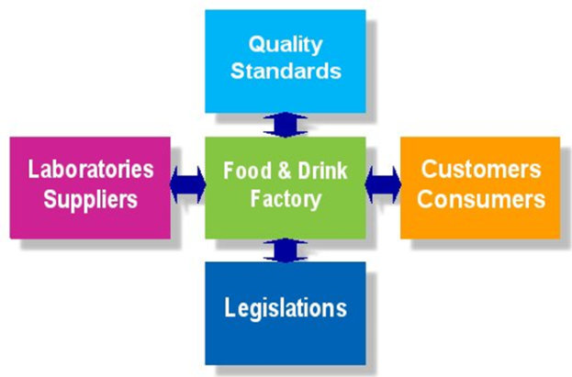
Legislation: HACCP
Hazard analysis
Overview of pathogens, chemical hazards
  Pathogenic bacteria
  Mycotoxins
  Other biotoxins
  Viruses, rickets and prions
  Parasites & Pests
  Chemical & Physical
  Zoonoses & Extensive Toxins
  Spoilers
Hazard analysis
  Control of raw material hazards
  Process hazard management
  HACCP-team
  Decision tree
  Control measures

Slide 7
Introduction
Food Safety Compliance
HACCP introduction
Methodology
    Prerequisite program
    Control measures
HACCP study: specific hazards
HACCP study: decision tree, raw materials and processes
Our company: HACCP
Legislation
    EU regulations & Information sheets & Recall
    Food Safety Authority
Notes:
7

Slide 8
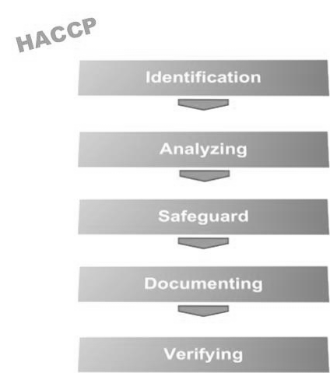

Slide 9

Analysis:
Physical hazards
Physical hazards usually involve foreign substances such as metal particles, glass, bones, or stones that can cause cuts in the mouth, break teeth, cause choking, or perforate the gastrointestinal tract.
This includes various materials such as those originating from land, animals, glass objects, metal objects etc. With respect to chemical and biological hazards, physical hazards are often visible and can be felt.

Slide 10
Analysis:
Chemical hazards
Chemical hazards include substances that adversely affect health, because they are acutely dangerous or because they cause damage in the long term. The following types of substances should be considered:
    Substances of natural origin,
    (Agricultural) chemicals,
    Environmental pollution.

Slide 11
Analysis:
Biological hazards
When making an inventory of the biological hazards, it is important to identify those factors and microorganisms that play a role in the occurrence of food spoilage, food infection, and food poisoning. The presence and occurrence of microorganisms in food is determined by three factors, namely:
    Factors determining the “introduction” (sources).
    Factors influencing the growth of microorganisms (conditions).
    Factors by which microorganisms are killed (processes).

Slide 12
Biological hazards:
Bacteria
Examples of infectious pathogens: Campylobacter jejuni, Salmonella, Shigella, Escherichia coli, Vibrio cholerae, Vibrio parahaemolyticus, Listeria, etc.
Examples of toxigenic pathogens: Bacillus cereus, Clostridium botulinum, Clostridium perfringens, Staphylococcus aureus, fungi, etc.

Slide 13
Biological hazards:
Viruses
Small round structured viruses (SRSV’s) appear to be the main cause of food-related viral infections.
The food-related infections are mainly caused by people contaminating ready-to-eat food.

Slide 14
Introduction
Food Safety Compliance
HACCP introduction
Methodology
    Prerequisite program
    Control measures
HACCP study: specific hazards
HACCP study: decision tree, raw materials and processes
Our company: HACCP
Legislation
    EU regulations & Information sheets & Recall
    Food Safety Authority
Notes:
14

Slide 15
Methodology
Firstly, the prerequisite program (PRP) must be completed.
The entire food safety plan is based on a prerequisite program, followed by HACCP-based procedures.
In the HACCP study, specific hazards are related to the raw materials and the processes.
For the purpose of clarifying generic hazards that are reduced to an acceptable level by means of the PRP, an additional control measure table has been drawn up to also operationalize the PRP in procedures.
This is not necessary according to the principles of HACCP.
The hazard analysis is based on the Codex Alimentarius, scientific documents and legal texts.
The hazard analysis has been drawn up per process step and per product (raw material, admixture, end products). This involved looking at microbiological, chemical, and physical hazards. All this according to the likelihood and consequence principle.

Slide 16
Prerequisite program
Prerequisite program
Reference: Codex Alimentarius, ‘General Principles of Food Hygiene’ CAC/RCP 1-1969, Rev. 3, 1997, Amended 1999.

Slide 17
Prerequisite program (1/6)
2. Establishment: design and facilities
2.1.1 Establishment
2.1.2 Equipment
2.2 Premises and rooms
2.2.1 Design and layout
2.2.2 Internal structures and fittings
2.2.3 Temporary / mobile premises, vending machines
2.3.1 General
2.3.2 Food control and monitoring equipment
2.3.3 Containers for waste and inedible substances
2.4.1 Water supply
2.4.2 Drainage and waste disposal
2.4.3 Cleaning
2.4.4 Personnel hygiene facilities and toilets
2.4.5 Temperature control
2.4.6 Air quality and ventilation
2.4.7 Lighting
2.4.8 Storage

Slide 18
Prerequisite program (2/6)
3.1 Control of food hazards
3.2.1 Time and temperature control
3.2.2 Specific process steps
3.2.3 Microbiological and other specifications
3.2.4 Microbiological cross contamination
3.2.5 Physical and chemical contamination
3.3 Incoming materials requirements
3.3.1 Specifications
3.3.2 Control at reception
3.3.3 Stock rotation
3.4 Packaging
3.4.1 Design and materials
3.4.2 ‘Food-grade’ materials and gases
3.4.3 Reusable packaging
3.5 Water
3.5.1 Water in contact with food

Slide 19
Prerequisite program (3/6)
3.5.2 Reuse of re-circulated water
3.5.3 Reuse of re-circulated, non-treated water
3.5.4 As an ingredient
3.5.5 Ice and steam
3.6 Management and supervision
3.6.1 Type of control and supervision
3.6.2 Knowledge required
3.7 Documentation and records
3.7.1 Retain records
3.7.2 Effectiveness and credibility
3.8 Recall procedures
3.8.1 Effective procedures
3.8.2 Tracing & Tracking
3.8.3 Destroy or reprocess

Slide 20
Prerequisite program (4/6)
4 Establishment: maintenance and sanitation
4.1 Maintenance and cleaning
4.1.1 General
4.1.2 Cleaning procedures and methods
4.2.1 Specifications
4.2.2 Monitoring and verification
4.3 Pest control
4.3.1 General
4.3.2 Preventing access
4.3.3 Harborage and infestation
4.3.4 Monitoring and detection
4.3.5 Eradication
4.4 Waste management
4.4.1 Removal, storage
4.4.2 Cleaning
4.5 Sanitation systems
4.5.1 Monitoring
4.5.2 Verification
4.5.3 Review

Slide 21
Prerequisite program (5/6)
5 Establishment: personal hygiene
5.1 Health status
5.1.1 Access prevention
5.2 Illness and injuries
5.2.1 Conditions to be reported
5.3 Personal cleanliness
5.3.1 Protective clothing
5.3.2 Cuts and wounds
5.3.3 Washing hands
5.4 Personal behavior
5.4.1 Smoking, eating, sneezing
5.4.2 Jewelry
5.5 Visitors
5.5.1 Cleanliness and behavior

Slide 22
Prerequisite program (6/6)
6 Transport
6.1 General
6.2 Requirements
6.3 Use and maintenance
7 Product information and consumer awareness
7.1 Batch identification
7.2 Product information
7.3 Labelling
7.4 Consumer education
8 Training
8.1 Awareness and responsibilities
8.2 Training programs
8.3 Instruction and supervision
8.4 Refresher training

Slide 23
Our company
Question 1: How does the Prerequisite program look like for our company?

Slide 24
Methodology specific hazards
In the HACCP study, specific hazards are related to the raw materials and the processes.
The hazard analysis is based on the Codex Alimentarius, scientific documents and legal texts.
The hazard analysis has been drawn up per process step and per product (raw material, admixture, end products). This involved looking at microbiological, chemical and physical hazards. All this according to the likelihood x consequence principle.

Slide 25
Introduction
Food Safety Compliance
HACCP introduction
Methodology
    Prerequisite program
    Control measures
HACCP study: specific hazards
HACCP study: decision tree, raw materials and processes
Our company: HACCP
Legislation
    EU regulations & Information sheets & Recall
    Food Safety Authority
Notes:
25

Slide 26
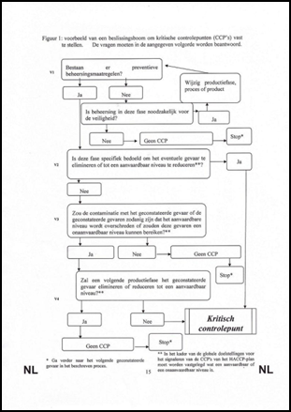
HACCP study: specific hazards
Hazard analysis
Overview of pathogens, chemical hazards
  Pathogenic bacteria
  Mycotoxins
  Other biotoxins
  Viruses, rickets and prions
  Parasites & Pests
  Chemical & Physical
  Zoonoses & Extensive Toxins
  Spoilers
Hazard analysis
  Control of raw material hazards
  Process hazard management
  HACCP-team
  Decision tree
  Control measures
Specific hazards: Codex approach
  Raw materials and information sheets like 64/65/85 (Dutch Authority)
  Processes
HACCP approach validated weekly in audits and part of the iMIS Food Updates.

Slide 27
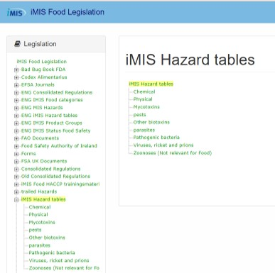
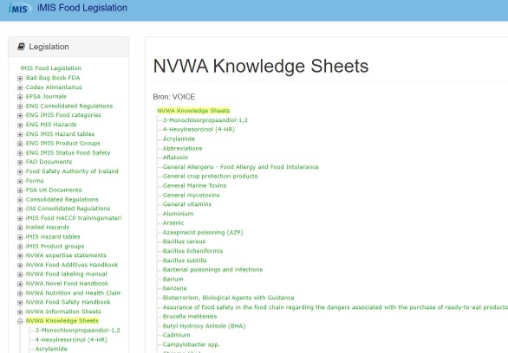
HACCP study: specific hazards background information

Slide 28
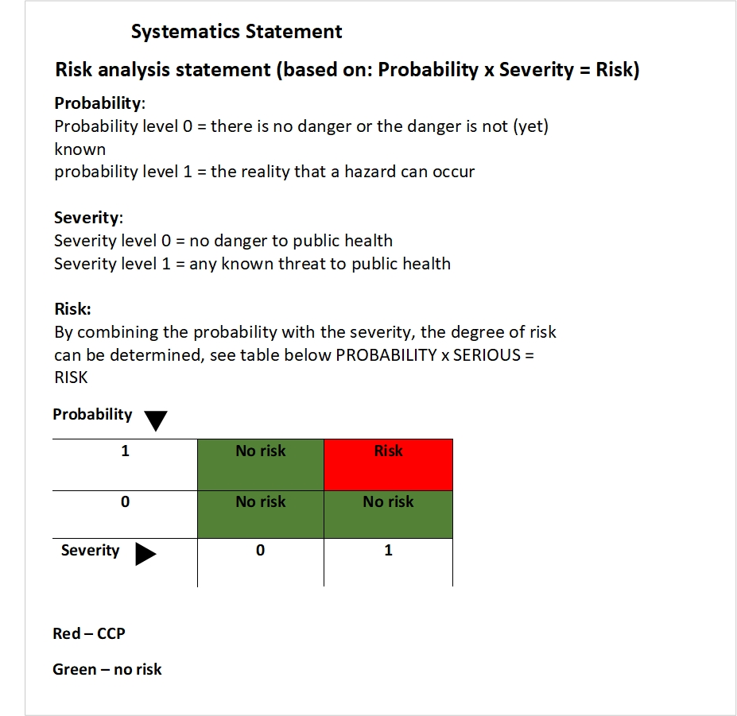
Risk determination method

Slide 29
Introduction
Food Safety Compliance
HACCP introduction
Methodology
    Prerequisite program
    Control measures
HACCP study: specific hazards
HACCP study: decision tree, raw materials and processes
Our company: HACCP
Legislation
    EU regulations & Information sheets & Recall
    Food Safety Authority
Notes:
29

Slide 30
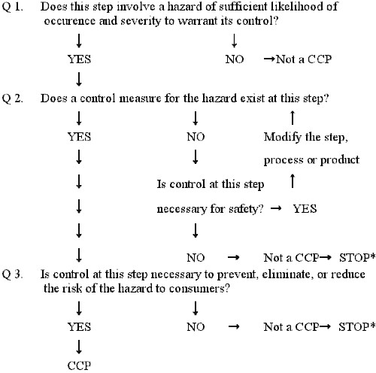
Decision tree

Slide 31
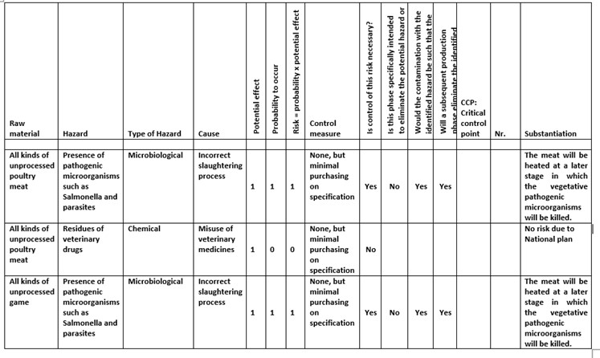
HACCP study: raw materials and processes

Slide 32
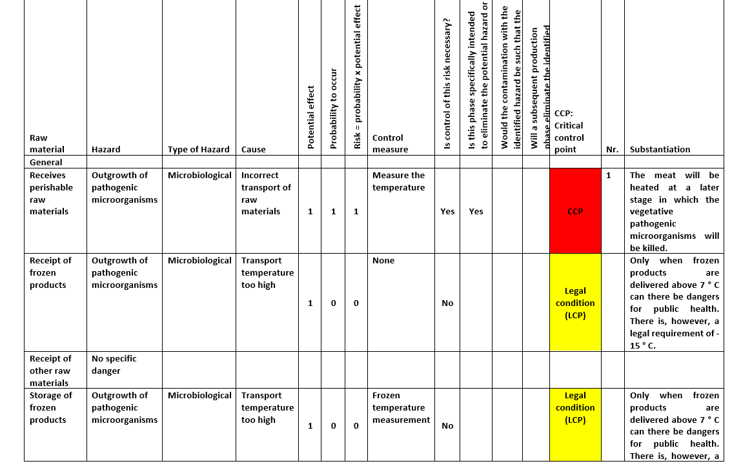
HACCP study: raw materials and processes

Slide 33
Introduction
Food Safety Compliance
HACCP introduction
Methodology
    Prerequisite program
    Control measures
HACCP study: specific hazards
HACCP study: decision tree, raw materials and processes
Our company: HACCP
Legislation
    EU regulations & Information sheets & Recall
    Food Safety Authority
Notes:
33

Slide 34
Our company
Question 2: How does the HACCP study look like for our company?
Question 3: How does the CCP and OPRP monitoring table look like?

Slide 35
Introduction
Food Safety Compliance
HACCP introduction
Methodology
    Prerequisite program
    Control measures
HACCP study: specific hazards
HACCP study: decision tree, raw materials and processes
Our company: HACCP
Legislation
    EU regulations & Information sheets & Recall
    Food Safety Authority
Notes:
35

Slide 36
Legislation: EU regulations
1990-496 Nutritional information
2002-178 General Food Law
2005-2073 Microbiological criteria
2005-396 Pesticide residues
2006-1881 Contamination of food
2006-1924 Nutrition and health claims
2008-1333 Additives
2008-1334 Aromas
2011-1169 Food information
Notes:
36

Slide 37
Legislation: Info Sheets & Knowledge Sheets
Info Sheets: how to deal with sampling
  Info sheet 64
  Info sheet 65
  Info sheet 85
Knowledge Sheets
  Food allergy and food intolerance
  Bioterrorism, biological agents with guideline
  Contaminants from PVC packaging
  Contaminants from packaging by irradiation
  Paralytic shellfish poisoning (PSP)
  Toxoplasma gondii
  Zoonoses
Notes:
37

Slide 38
Legislation: Recall
2002-178 General Food Law
Article 19: By order of competent authority
Office for risk assessment
Reporting guide
Issue management
RASFF - Food and Feed Safety Alerts
Notes:
38

Slide 39
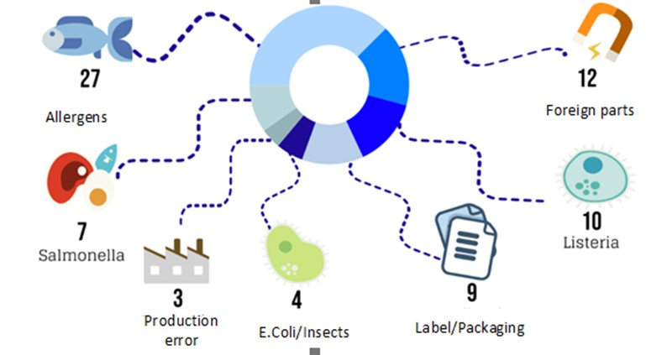
Legislation: Dutch recalls 2019
Notes:
39

Slide 40
Our company
Question 4: What does our Recall procedure look like?
  Does this refer to the reporting guide?
  Does it state when the certifier must be contacted?

Slide 41
Food Safety Authority
1. Tracing
  Properly recording the current method of tracing all normal products as well as any biological flow.
  Describe any missing trace actions in more detail and record them in additional records.
  Method of tracing closed weekly: demonstrably correct.
2. Additives
  Raw materials, Recipes, End products up to date
  2 E-number analysis on this product portfolio
  Keep E-number analysis up to date

Slide 42
Food Safety Authority
3. Microbiology
  Check microbiological plan for legislation.
  Check microbiological plan last year for compliance.
  Carefully implement current year microbiological plan.
4. Listeria
  Demonstrable compliance with Listeria legislation.
  Analysis of current product portfolio in which FSSP (listeria modeling software) must be substantiated with, among others, why Challenge tests have or have not been carried out.
  Describe the Listeria approach that demonstrably meets the legal requirements.

Slide 43
Food Safety Authority
5. STEC
  5A Using the product portfolio, analyze which raw products to be consumed can have STEC as a problem.
  5B Conform STEC to EU policy and guarantee these products regarding STEC
  5C Info sheet 64 of Dutch Authority (NVWA) considered for STEC
6. Electronical Data Processing (EDP) audit
  6A Administrations may be taken without any reason / suspicion
Notes:
43

Slide 45
Part 2: Contents
Food Safety Compliance
FSSC22000
What should you pay attention to?
FSSC22000, version 5 HLS
QESH standards
HACCP team: tasks
HACCP team: annual reports
Notes:
45

Slide 46
Contents
Food Safety Compliance
FSSC22000
What should you pay attention to?
FSSC22000, version 5 HLS
QESH standards
HACCP team: tasks
HACCP team: annual reports
Notes:
46

Slide 47
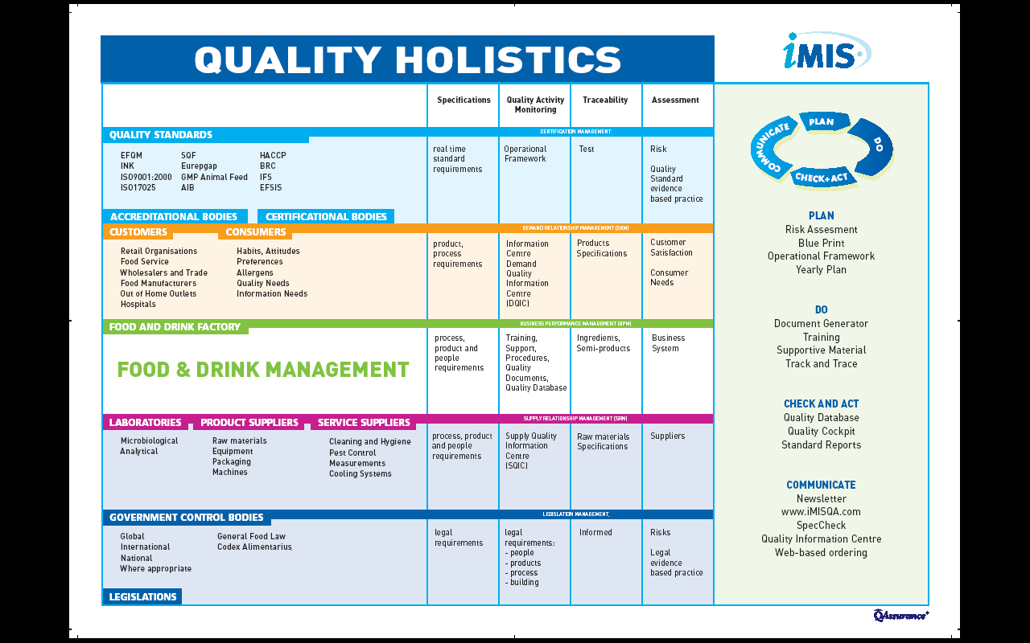
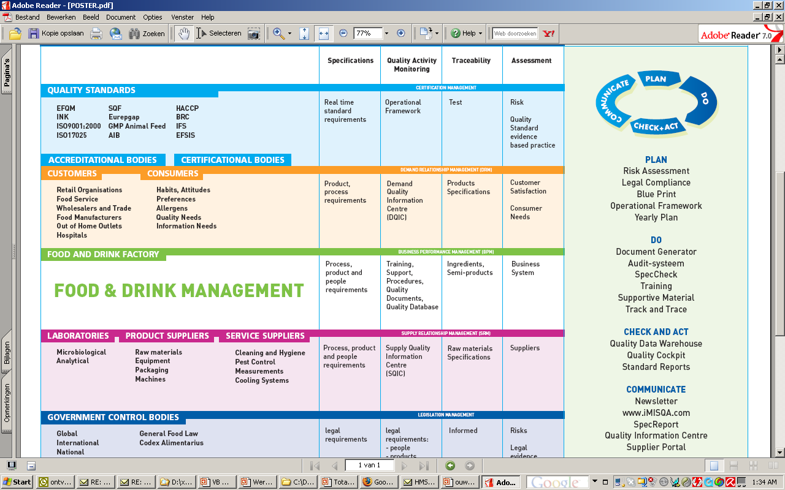
Notes:
47

Slide 48
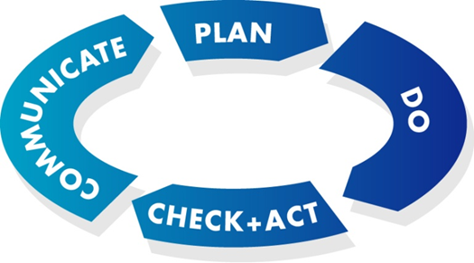
iMIS Food content & software
iMIS: integral Management & Information System
Food: for real-time management of food safety
Content
  Operational framework for food safety
  Food Safety standards: HACCP, FSSC22000, BRC, IFS
  Extra for QESH: ISO9001, 14001, 26000
Software
  User-friendly
Notes:
48

Slide 49
Food Management:
  Dynamic playing field
  2000 quality requirements
  100 suppliers
  100 customers
  100 employees
  400 legislative changes
Notes:
49

Slide 50
Standards
Quality:
  BRC
  IFS
  FSSC22000
  SQF
  Dutch HACCP
  Quality marks such as HALAL, SKAL, UTZ
Environment: ISO14001
Occupational health and safety: ISO45001
Corporate Social Responsibility:
  CSR Performance Ladder (ISO26000)
Notes:
50

Slide 51
Standards
Food Production parameters
  Product
  Process
  Person
  Production area
Food Defense
Food Fraud
Not just for production: traders too
  HACCP of the entire chain
Retail customer? 2 Certifying Institutes and 2 Certificates!
Freelance auditors…
Organic certification <-> Food Safety Authority <-> EDP audit
Notes:
51

Slide 52
Standards in practice
Most food companies are BRC, IFS, or FSSC22000 certified
What are the differences and similarities between these standards?
How do you set up your quality system, documentation, and compliance?
How do you deal with difficult audit situations?
As a company, can you cancel the audit yourself if you want to?
Based on more than 500 audits, knowledge is transferred about how you can best demonstrably meet the quality standards
How are the certification bodies organized?
Expand the food safety system to ISO9001, ISO14001 and the CSR performance ladder

Slide 53
Contents
Food Safety Compliance
FSSC22000
What should you pay attention to?
FSSC22000, version 5 HLS
QESH standards
HACCP team: tasks
HACCP team: annual reports
Notes:
53

Slide 54

FSSC22000
FSSC 22000 stands for Food Safety System Certification 22000 and is an internationally recognized form of demonstrable food safety.
The FSSC 22000 has its origins in the Codex Alimentarius and is a standard developed by the Foundation for Food Safety Certification
The FSSC 22000 standard is becoming increasingly popular within the food industry, because it has been approved by the GFSI (Global Food Safety Initiative).
Notes:
54

Slide 55
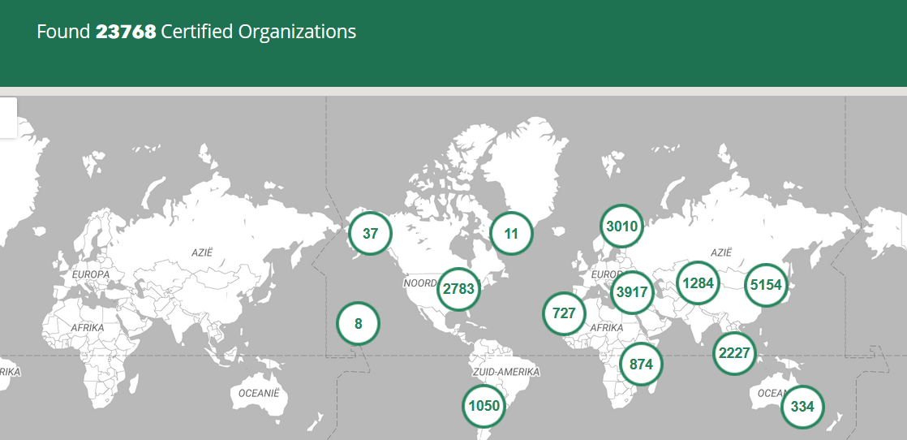
FSSC

Slide 56
What is FSSC 22000 based on?
ISO 22000:2018
Sector specific Pre-Requisite Program (PRP) ISO/TS 22002
Specific FSSC 22000 requirements
The FSSC 22000 standard is a food safety management system that focuses on the PDCA approach
Both at the organizational level and at the operational level
Focus on risk-based thinking and in the field of HACCP

Slide 57
ISO22000: standard requirements
4 Context of the organization
5 Leadership
6 Planning
7 Support
8 Operation
9 Performance evaluation
10 Improvement

Slide 58
ISO/TS 22002 15 standard requirements
4 Construction and layout of buildings
5 Layout of premises and workspace
6 Utilities – air, water, energy
7 Waste disposal
8 Equipment suitability, cleaning and maintenance
9 Management of purchased materials
10 Measures for prevention of cross contamination

Slide 59
ISO/TS 22002 15 standard requirements
11 Cleaning and sanitizing
12 Pest control
13 Personnel hygiene and employee facilities
14 Rework
15 Product recall procedures
16 Warehousing
17 Product information/consumer awareness
18 Food defense, biovigilance and bioterrorism
FSSC 22000 does not work with scores on the certificate. There is, however, a three-year cycle in which one unannounced audit is compulsory in those three years.

Slide 60
FSSC22000 audits
Do not forget the appendix: extra standard requirements (nice surprise during an audit if these are not explained in the cross table)
FSSC 22000 does not work with scores on the certificate. There is, however, a three-year cycle in which one unannounced audit is compulsory in those three years.
Use PAS 96 for Food Defense

Slide 61
Other standards relative to FSSC 22000
The big difference between FSSC 22000 and, for example, the BRC and IFS, is that there is no checklist stating exactly what is and what is not accepted (as is the case with BRC/IFS)
The FSSC 22000 standards leaves more room for interpretation and personal insight. This is both an advantage and disadvantage.
Certain risks can be excluded by means of well-founded arguments in the HACCP-analysis. In this way, a practical and workable system can be created for every company.

Slide 62
Contents
Food Safety Compliance
FSSC22000
What should you pay attention to?
FSSC22000, version 5 HLS
QESH standards
HACCP team: tasks
HACCP team: annual reports
Notes:
62

Slide 63
What should you pay attention to?
Do not forget Appendix FSSC, including services
Knock Outs at IFS
Fundamentals at BRC
Management board expectation:
  80% of audit results dependent on the auditor
  Focus with QA on a working system AND do not use the standard as an improvement tool.
  BRC and IFS are often a settlement instrument, make sure that everything is correct on the days of the audit and that open action points that are standard related are also resolved.
  Enough QA managers and advisors can wrongly do something else after an undesired score.

Slide 64
What should you at least arrange properly?
Food Production parameters
  Product: product assurance & development
  Process : Cleaning and disinfection
  Person: screening for diseases and hygienic working
  Production area
Food Defense
Food Fraud
Evidence Based practice:
Evidence: everything done for food safety
Make sure all data is stored in the company! Code microbiology so that you don’t fall victim to external errors.
Plant Based chilled // ready to heat
Notes:
64

Slide 65
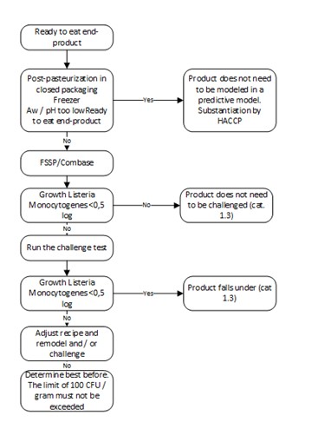
What should you at least arrange properly?
Make sure everyone knows the location of:
  HACCP study
  Management reports
  Listeria and additives overview
Train relevant colleagues in
  The management system
  HACCP
  Internal auditing
  Location information sources
  Traceability
  ERP system and Backups
Use a separate system for consumer & chain information
Notes:
65

Slide 66
Contents
Food Safety Compliance
FSSC22000
What should you pay attention to?
FSSC22000, version 5 HLS
QESH standards
HACCP team: tasks
HACCP team: annual reports
Notes:
66

Slide 67
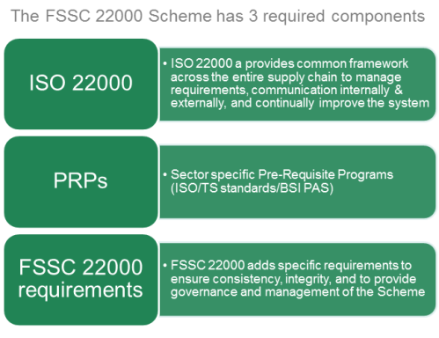
FSSC22000 version 5: general
Notes:
67

Slide 68
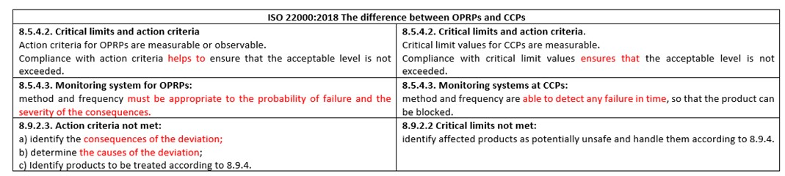
FSSC22000 version 5: general
Notes:
68

Slide 69
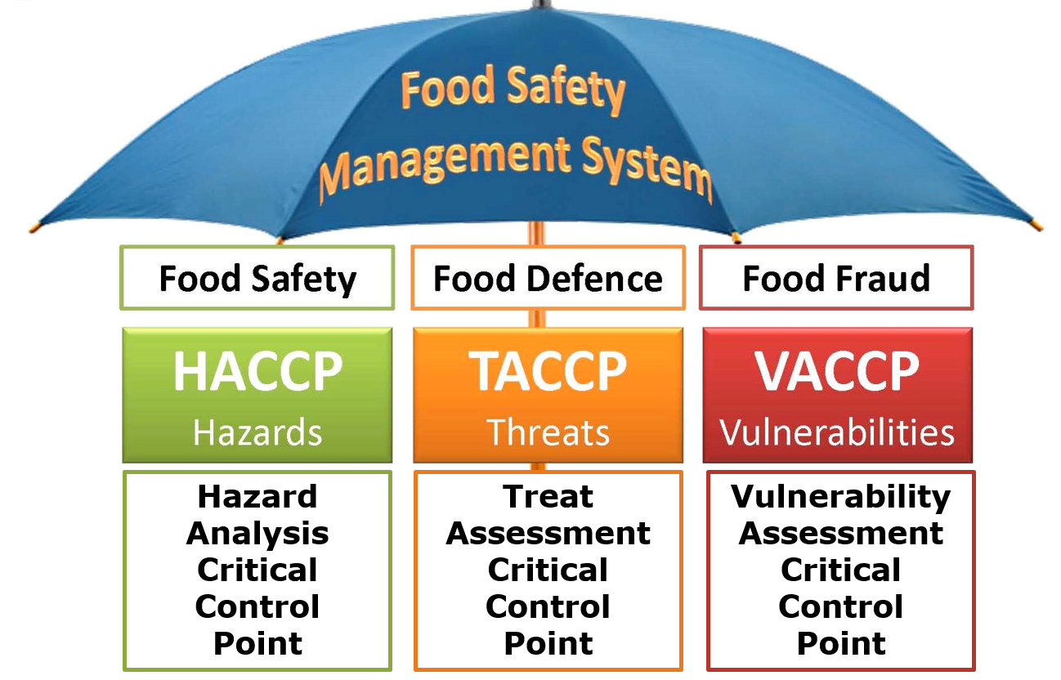
FSSC22000 version 5: general
iMIS Food: procedures for Food Defense and Food Fraud
TACCP and VACCP reports based on FSSC guidelines
Notes:
69

Slide 70
10 clause structure - Main clauses of High Level Structure (HLS)
01
Scope
06
Planning
02
Normative references
07
Support
FSSC22000 version 5: ISO22000 changes
03
Terms and definitions
08
Operation
04
Context of the organization
09
Performance evaluation
05
Leadership
10
Improvement
Notes:
Core clauses are the same with other standards(HLS), but in 08 operation changes
70

Slide 71
FSSC22000 version 5: ISO22000 changes
Organizational planning and control
Risk on 2 levels
Strategic
Company risks
Management is leading
Operational
HACCP
QA is leading
PLAN (FSMS)
4. Context of the organization
5. Leadership
6. Planning
7. Support*
DO (FSMS)
8. Operation
CHECK (FSMS)
9. Performance evaluation
ACT (FSMS)
10. Improvement
Operational planning and control
PRPs
Hazard analysis
Validation of control measures
Hazard contol plan (HACCP/oPRP plan)
Verification planning
Traceability system
Emergency preparedness & response
PLAN (food safety)
Updating of preliminary information and documents specifying the PRPs and the hazard control plan
Verification activities
Implementation of the PLAN (food safety)
Analysis of results of verification activities
Control of monitoring and measuring
Control of products & process nonconformities
ACT (food safety)
CHECK (food safety)
DO (food safety)
Notes:
71

Slide 72
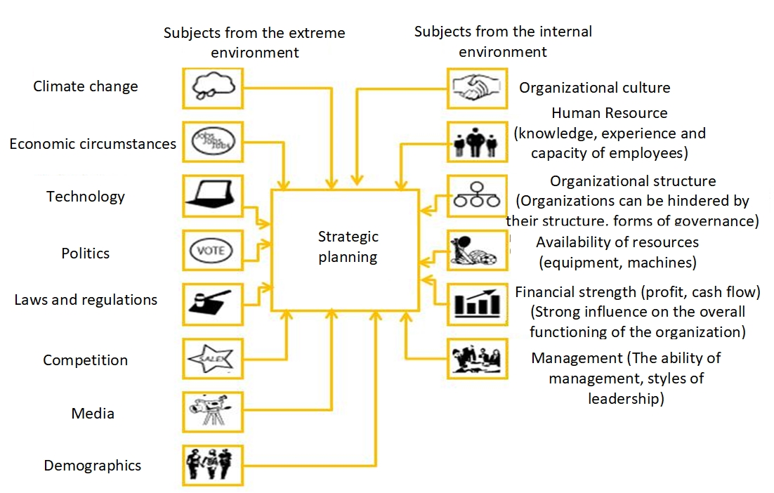
FSSC22000 version 5: Context analysis and SWOT
Notes:
72

Slide 73
6.1 Actions to address risks and opportunities
FSSC22000 version 5: Context analysis and SWOT
When planning for the food safety management system, the organization should consider the topics listed in 4.1 and the requirements listed in 4.2, and identify the risks and opportunities that need to be addressed to:
To ensure that the food safety management system achieves its intended result;
Prevent or reduce unwanted effects;
Achieve continuous improvement.
The organization must:
Plan actions to address these risks and opportunities
Plan in which way:
The measures are integrated and implemented in its food safety management system processes;
The effectiveness of these measures should be evaluated.
Notes:
73

Slide 74
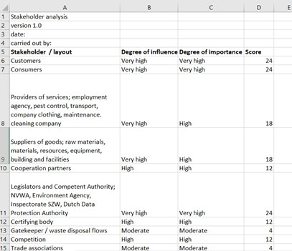
FSSC22000 version 5: Context analysis and SWOT

Slide 75
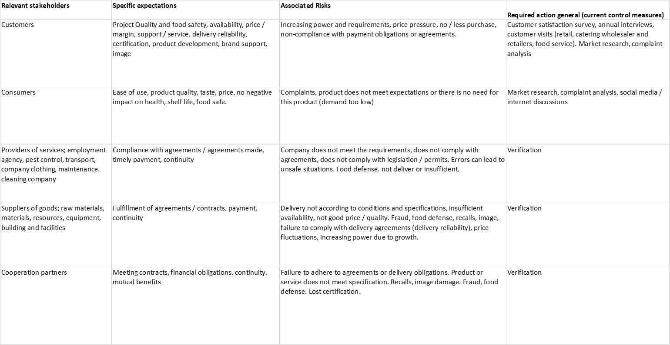
FSSC22000 version 5: Context analysis and SWOT
Step 1 Determining stakeholder: all stakeholders with a score of 8 or higher are considered relevant
Step 2 Determining expectation from a stakeholder’s point of view

Slide 76
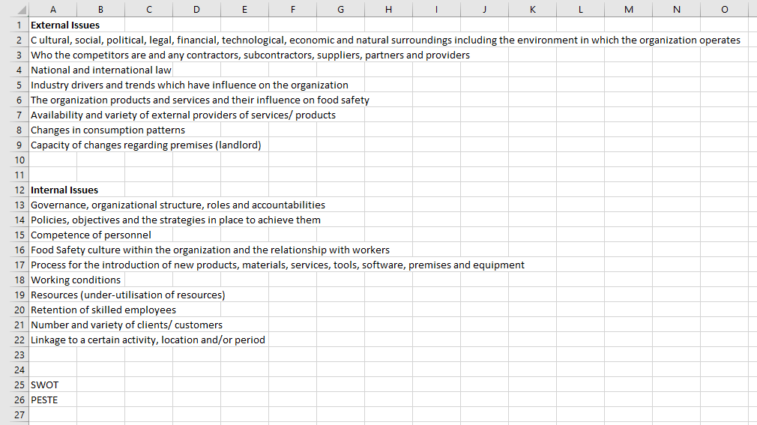
FSSC22000 version 5: Context analysis and SWOT
Step 1 Determining stakeholder: all stakeholders with a score of 8 or higher are considered relevant
Step 2 Determining expectation from a stakeholder’s point of view
Step 3 Risk analysis: internal and external issues

Slide 77
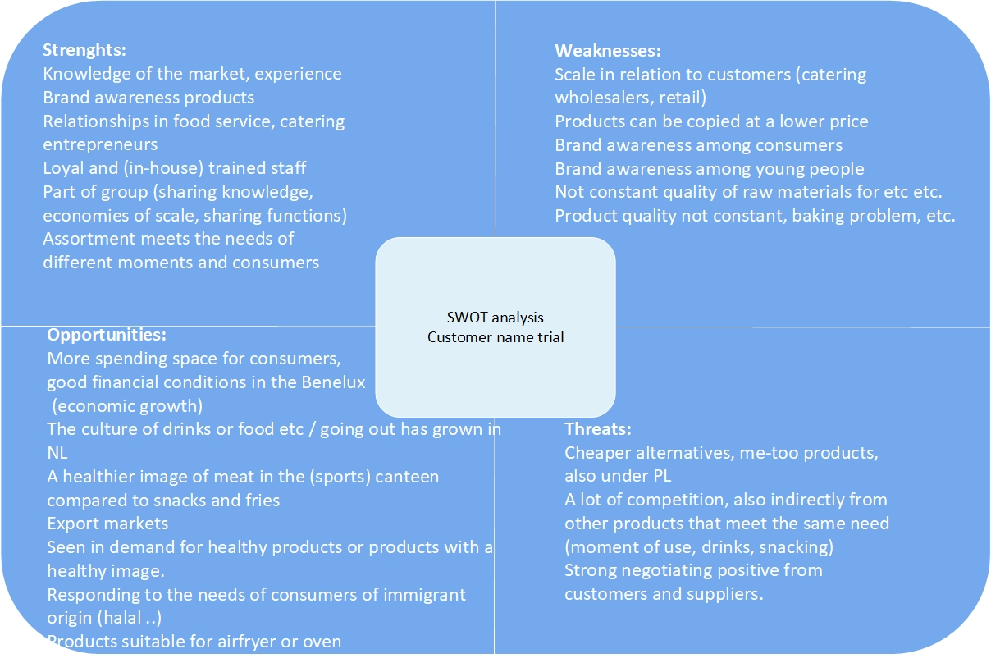
FSSC22000 version 5: Context analysis and SWOT

Slide 78
Our company
How is our context analysis, stakeholder analysis and SWOT?
  Same for the TACCP and VACCP study
  How is our procedure for Food Defense and Food Fraud?

Slide 79
Contents
Food Safety Compliance
FSSC22000
What should you pay attention to?
FSSC22000, version 5 HLS
QESH standards
HACCP team: tasks
HACCP team: annual reports
Notes:
79

Slide 80
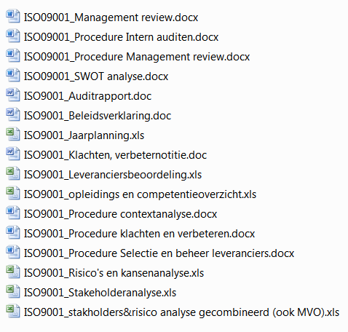
IS09001

Slide 81
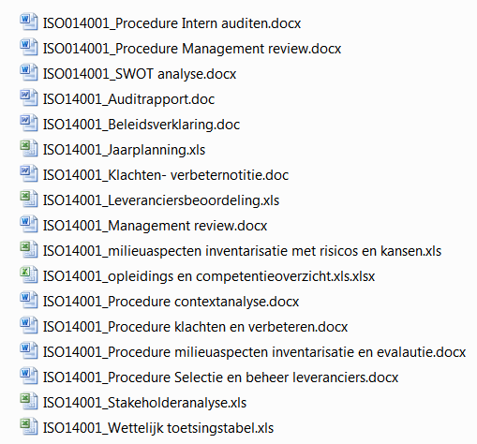
ISO14001

Slide 82
Contents
Food Safety Compliance
FSSC22000
What should you pay attention to?
FSSC22000, version 5 HLS
QESH standards
HACCP team: tasks
HACCP team: annual reports
Notes:
82

Slide 83
HACCP team: tasks (1/2)
The HACCP team has the following responsibilities:
  Conduct a hazard analysis to determine which hazards need to be controlled, which degree of control is required to achieve food safety and what combination of control measures is required.
  Plan and implement processes necessary for the validation of control measures and/or combinations of control measures, and to improve the food safety management system verification and improvement.
  Assess changes in the production process that have a negative effect on the food safety.
  Verification of the food safety system.
  Indicate per process step, including all products, all processes and all elements of the PRP on which these have been assessed and justify whether it is a Critical Control Point (CCP or OPRP).
  Check whether the food safety system falls within the scope and whether the scope covers the entire food safety system.
  Make adjustments to keep the food safety system up to date and correct either by verification or validation.

Slide 84
HACCP team: tasks (2/2)
Management of training courses for staff to ensure that everyone has sufficient knowledge related to the necessary food safety.
Determining and verifying the scope.
In case of changes in raw materials, packaging materials, processing methods, infrastructure and/or equipment, the HACCP plan is revised to ensure that the product safety requirements are met.
In the hazard analysis, attention is also paid to the position in the chain and will be taken into account with our suppliers and customers.
It is essential that the HACCP team has sufficient expertise. The expertise and composition of the HACCP team is recorded in the HACCP team responsibility overview. Due to the current composition of the HACCP team, all necessary knowledge and expertise is available for the daily course of events. For additional specific information, QAssurance B.V. is used.
The HACCP team has the approval of the management and is supported where possible with
the necessary resources, facilities and time.

Slide 85
HACCP meetings
An HACCP team consultation takes place according to a fixed frequency in which it is at least assessed whether:
  The food safety system is up-to-date and effective.
  The measures taken have been adequately implemented/taken.
  New processes and/or products must be or have been assessed.
  Developments with regard to legislation, technology, knowledge, etc. that have an impact on us.
  Incidents or new information regarding food fraud or food defense that affect us.
  Furthermore, any calamities and standard violations are reviewed and possible improvements identified. The realization of formulated objectives are assessed and the identified cause is investigated in the event of non-achievement of targets. Then the measures are defined.
  The meetings are reported.

Slide 86
HACCP team: input (including from directive)
New products;
New raw materials;
New excipients;
Recipe adjustments;
New or changed processes, investments;
New location of equipment or environment;
New suppliers of product or service, new services;
New customer requirements that need to be translated to the shop floor;
Changes in cleaning and disinfection (method, means, frequency, etc.);
Possible legal changes or changes in standards;
Changes in packaging and/or packaging material;
Changes in storage or transport;
Changes in the organisation, competences, responsibilities and authorities;
Complaints and alerts;
State of the art, new knowledge, research results;
New knowledge about food safety hazards and control measures;
Quality Level changes
Objectives.

Slide 87
Our company
Who is in the HACCP team why; and who is the HACCP team leader?
What are the latest HACCP procedures?
What were the latest changes in the company that have an impact on the study?
When was the last time validated?
What about the central action list and what is the next annual plan?

