Slide 1
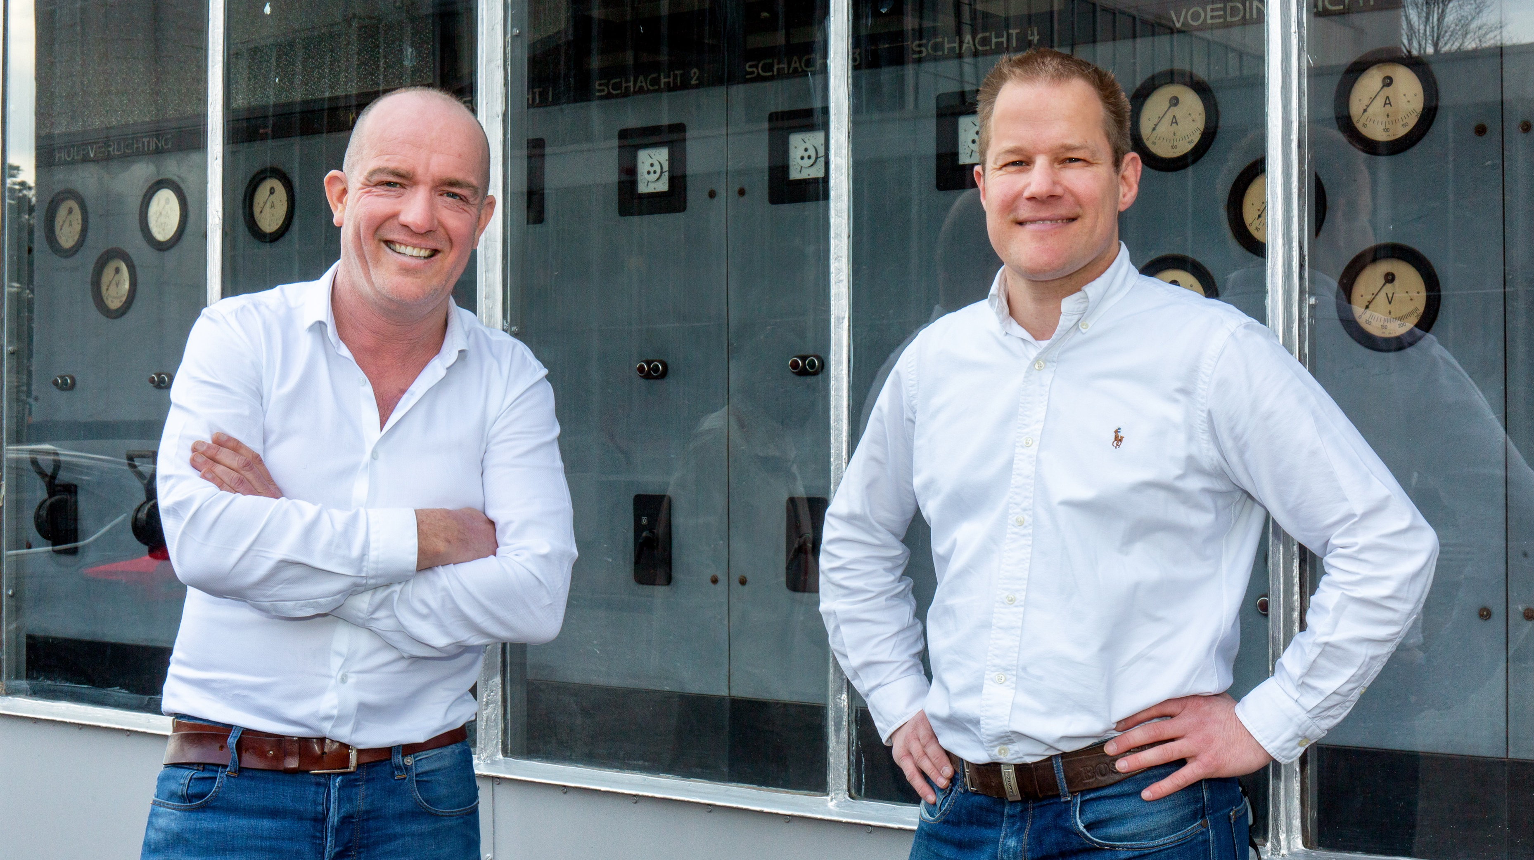
Real-time Food Safety Compliance system and direct access to Food Safety Experts
copyright www.qassurance.com , +31-10-2004080

Slide 2
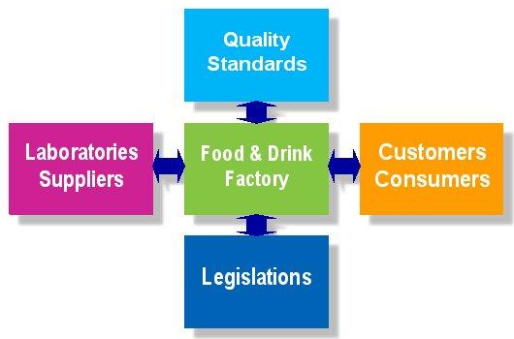
QAssurance
Mission:
We enable companies in the Food Supply Chain to manage Food Safety Compliance
Food Safety Experts
copyright www.qassurance.com , +31-10-2004080
Notes:
2

Slide 3
copyright www.qassurance.com , +31-10-2004080
Notes:
3

Slide 4
Introduction
QAssurance
iMIS Food
copyright www.qassurance.com , +31-10-2004080
Notes:
4

Slide 5
iMIS Food contents & software
iMIS: Integral Management & Information System
Food: for real-time management of food safety
Content
Operational framework for food safety
Food Safety standards: FSSC22000, BRC, IFS, SQF
Software
User-friendly
copyright www.qassurance.com , +31-10-2004080
Notes:
5

Slide 6
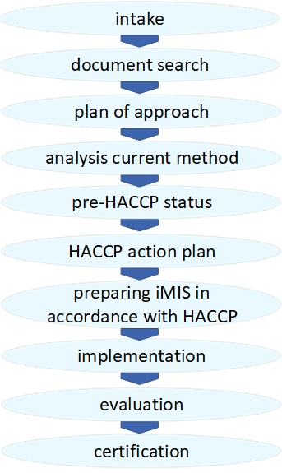
iMIS Food guidance by QAssurance
Implementation
Starting up iMIS Food
Short duration
Support
Daily use
iMIS Food Helpdesk
Training
iMIS Food software
HACCP and legislation
Labeling
copyright www.qassurance.com , +31-10-2004080
Notes:
6

Slide 7
iMIS Food the benefits
Company/Trademark Protection
Quality
Efficiency
Comply with the legal requirements
Meet the quality standards
No surprises, as management continuously knows what the status is
Continuity, by not being person dependent
Professional appearance towards the customer
Real-time availability of quality data
Knowledge system: formalization and security of knowledge
Effectiveness: real-time food safety based on expertise
Decisions based on facts
No unnecessary investments to meet standards
Integrated cost savings: one-time actions
90% of QA administration without specific background
Flexibility: company and not person dependent
Direct access to iMIS Food experts
Multiple locations possible
copyright www.qassurance.com , +31-10-2004080
Notes:
7

Slide 8
iMIS Food
System | Management of
Handbook | the quality manual
Audit | the inspections
SpecCheck | Specifications
Tracking | traceability
Intranet | central documentation
Updates | legislation & hazards
Helpdesk | online daily support
copyright www.qassurance.com , +31-10-2004080

Slide 9
iMIS Food
System | Management of
Handbook | the quality manual
Audit | the inspections
SpecCheck | Specifications
Tracking | traceability
Intranet | central documentation
Updates | legislation & hazards
Helpdesk | online daily support
copyright www.qassurance.com , +31-10-2004080

Slide 10
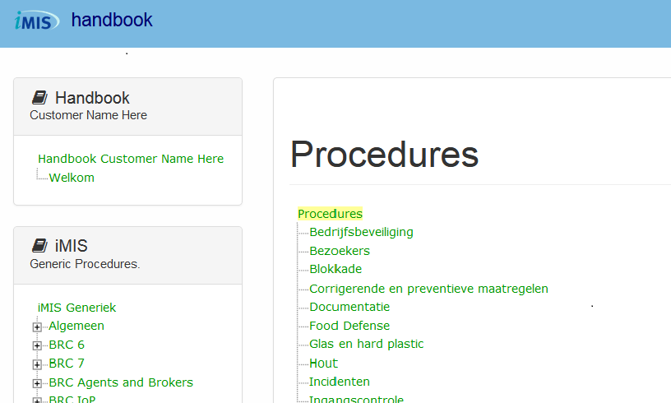
iMIS Food Handbook website
copyright www.qassurance.com , +31-10-2004080

Slide 11
iMIS Food Handbook HACCP
Overview of pathogens, chemical hazards
Pathogenic bacteria
Mycotoxins
Other biotoxins
Viruses, rickets and prions
Parasites & Pests
Chemical & Physical
Zoonoses & Extensive Toxins
Spoilers
Hazard analysis
Control of raw material hazards
Process hazard management
HACCP-team
Decision tree
Control measures
HACCP approach validated weekly in audits and part of the iMIS Food Updates
copyright www.qassurance.com , +31-10-2004080

Slide 12
iMIS Food Handbook general procedures
Specifications
Complaints
Food Defense
Visitors
Calibration
Release of products
General research
Traceability
Internal audit
Recall
Foreign objects
Customer and customer satisfaction
Management review
Supplier assessment
Product development
Education and training
Incidents
Wood
Glass and hard plastic
Quarantine
Maintenance
Pest control
Business security
Documentation
Validation & Verification
Corrective measures
copyright www.qassurance.com , +31-10-2004080

Slide 13
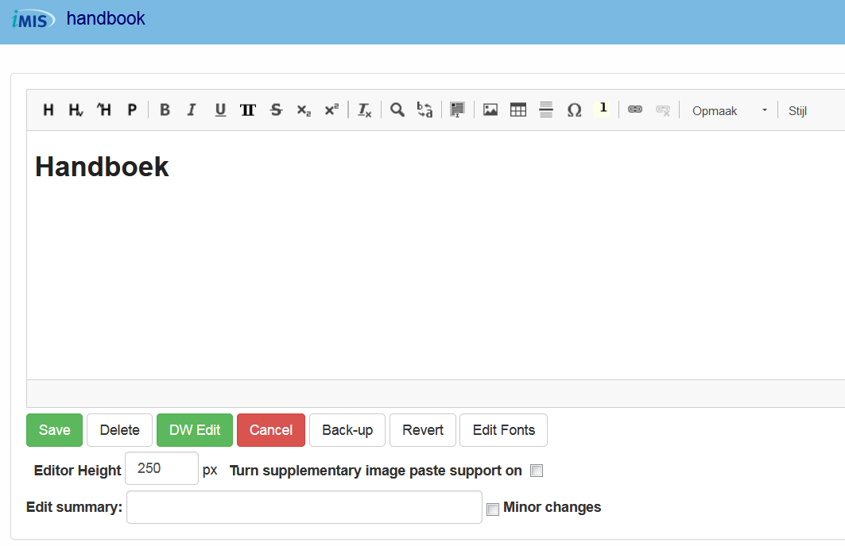
iMIS Food Handbook management system
Word processor
Permissions
Indexing
Search function
Changes
Version management
copyright www.qassurance.com , +31-10-2004080

Slide 14
iMIS Food
System | Management of
Handbook | the quality manual
Audit | the inspections
SpecCheck | Specifications
Tracking | traceability
Intranet | central documentation
Updates | legislation & hazards
Helpdesk | online daily support
copyright www.qassurance.com , +31-10-2004080

Slide 15
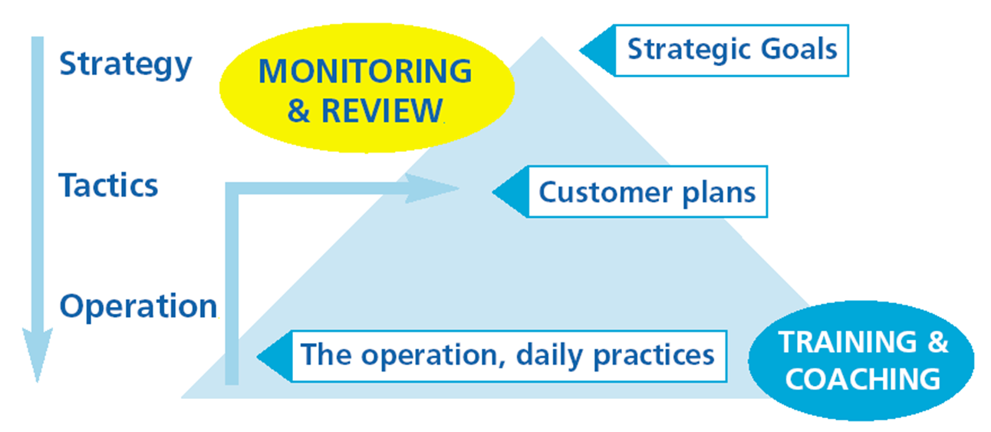
iMIS Food Audit the control system
Product checks
Process checks
Central action list
Cause analysis
Verification
Reports
copyright www.qassurance.com , +31-10-2004080
Notes:
15

Slide 16
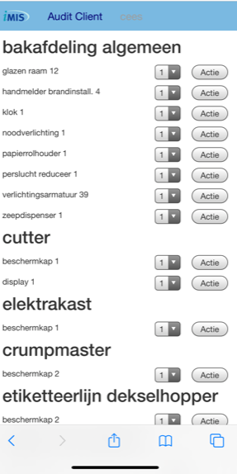
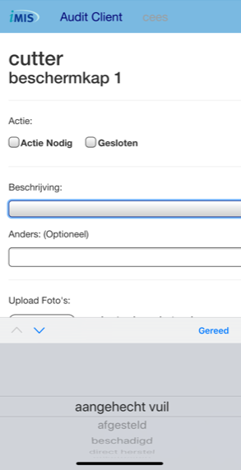
iMIS Food Audit Windows and IOS, Android via web interface
copyright www.qassurance.com , +31-10-2004080

Slide 17
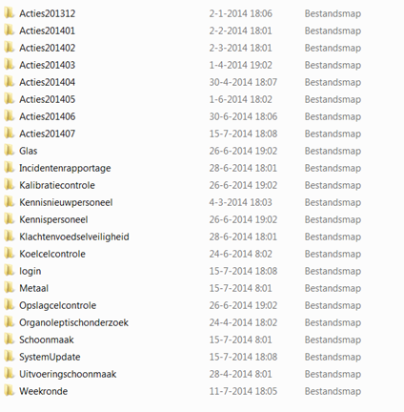
iMIS Food Audit management system
copyright www.qassurance.com , +31-10-2004080

Slide 18
iMIS Food
System | Management of
Handbook | the quality manual
Audit | the inspections
SpecCheck | Specifications
Tracking | traceability
Intranet | central documentation
Updates | legislation & hazards
Helpdesk | online daily support
copyright www.qassurance.com , +31-10-2004080

Slide 19
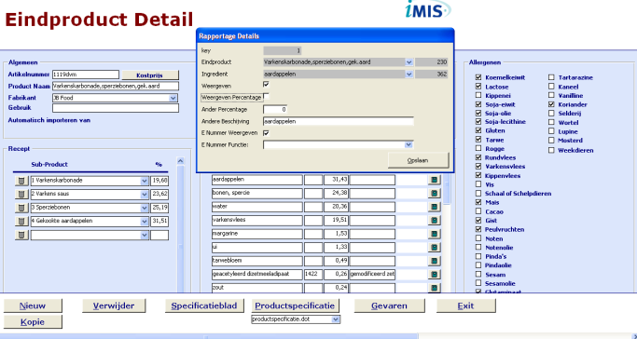
iMIS Food SpecCheck the specification management system
Correct specifications
Raw materials and end products
Allergens
Nutritional values
Ingredient declarations
Country of origin
Cost accounting
Real-time overviews
Allergens
Recipes changes
Management system
Approval procedure
Version control
Recording of all actions
Multiple languages
Import/Export function for data
copyright www.qassurance.com , +31-10-2004080
Notes:
19

Slide 20
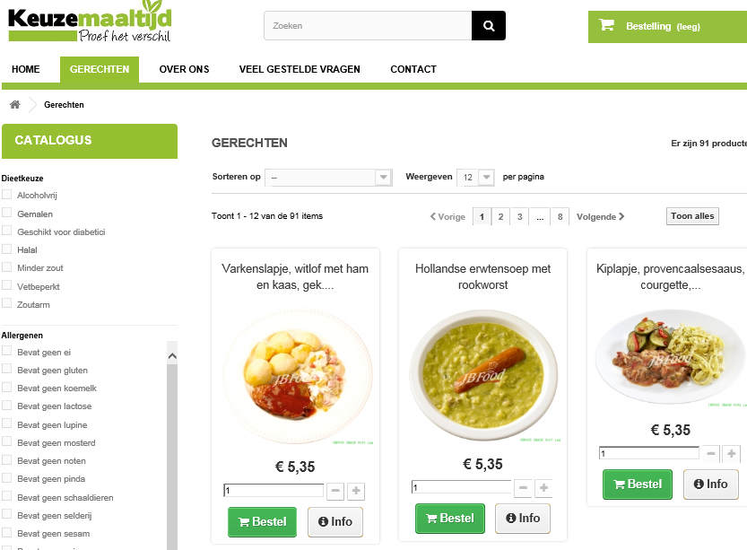
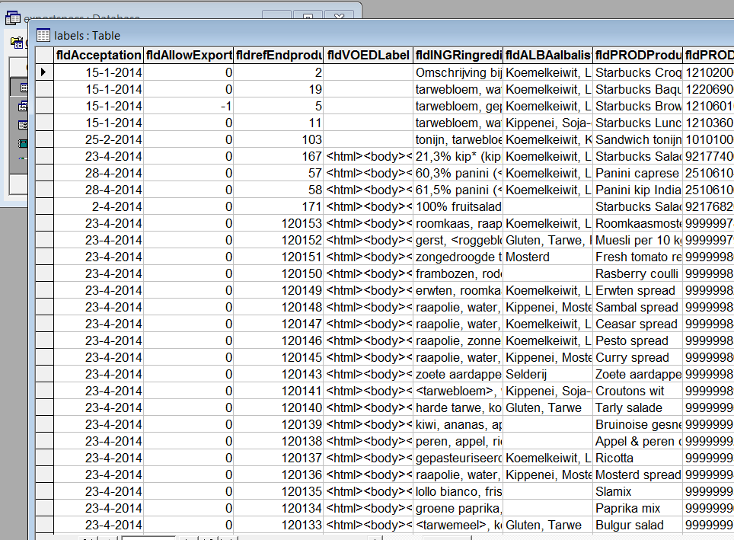
iMIS Food SpecCheck label information and export database
Export to ERP system & web shop
copyright www.qassurance.com , +31-10-2004080

Slide 21
iMIS Food
System | Management of
Handbook | the quality manual
Audit | the inspections
SpecCheck | Specifications
Tracking | traceability
Intranet | central documentation
Updates | legislation & hazards
Helpdesk | online daily support
copyright www.qassurance.com , +31-10-2004080

Slide 22
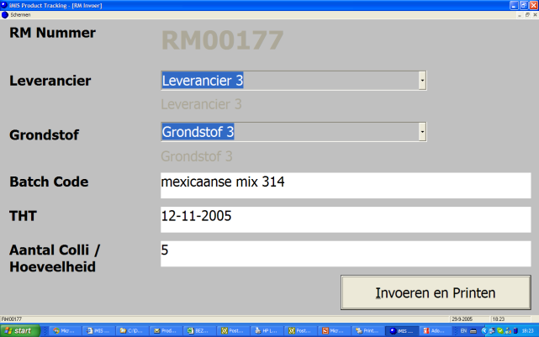
iMIS Food Tracking the tracing system
Tracing
Checking
Import/Export function for data
Raw materials & additives
Semi-finished & end products
Maintenance & Sampling
Entry check
Management of best before dates
Overviews:
Raw materials in use
Realized production
Delivered products and to whom
copyright www.qassurance.com , +31-10-2004080
Notes:
22

Slide 23
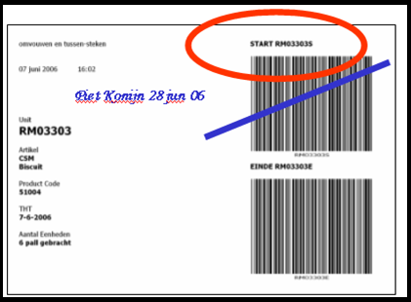
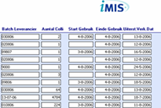
iMIS Food Tracking ERP supplement: internal tracing
copyright www.qassurance.com , +31-10-2004080

Slide 24
iMIS Food
System | Management of
Handbook | the quality manual
Audit | the inspections
SpecCheck | Specifications
Tracking | traceability
Intranet | central documentation
Updates | legislation & hazards
Helpdesk | online daily support
copyright www.qassurance.com , +31-10-2004080

Slide 25
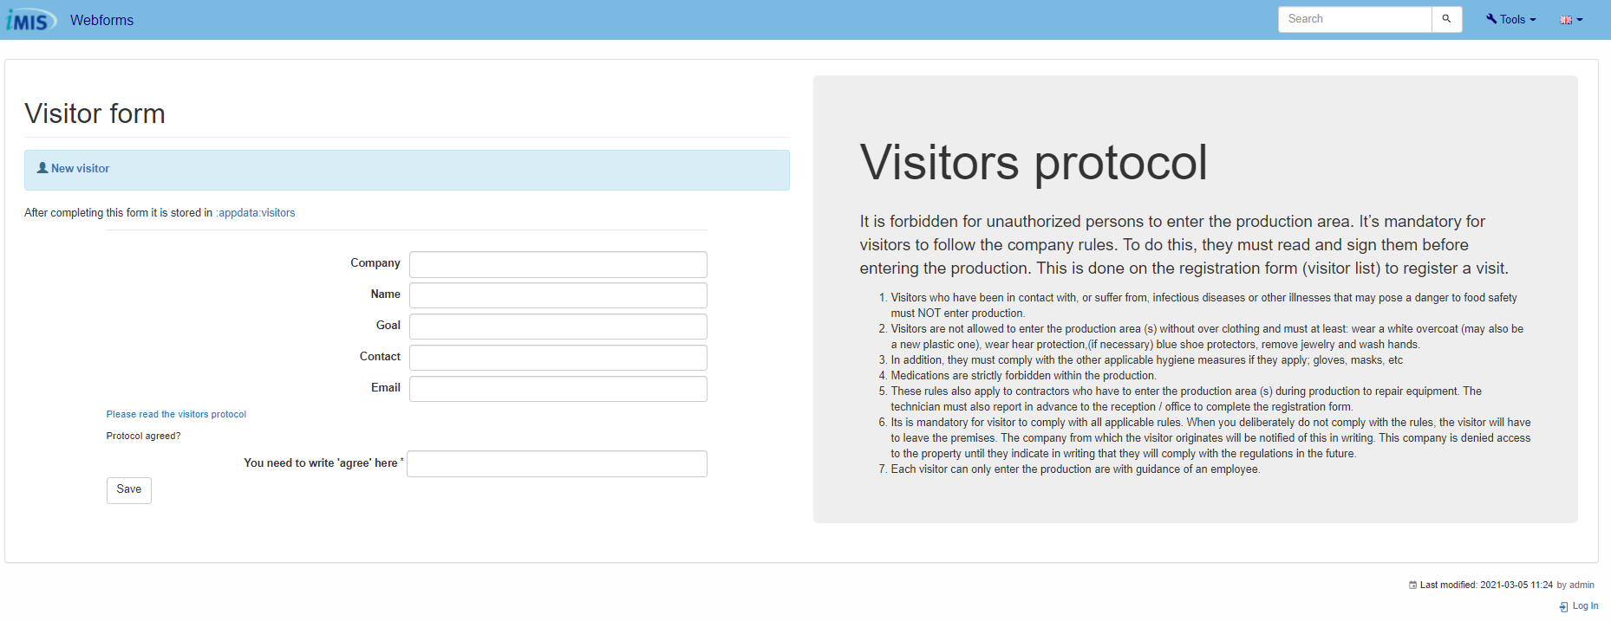
iMIS Food Intranet the intranet and portal system
iMIS Food Intranet
Handbook
Legislation
Calendar
Planning QA activities
Control rounds performed
Overviews
Planning
Control rounds performed
Approved product specifications
Webforms
Documentation system
Portal: You can determine which information is also accessible via the internet
copyright www.qassurance.com , +31-10-2004080
Notes:
25

Slide 26
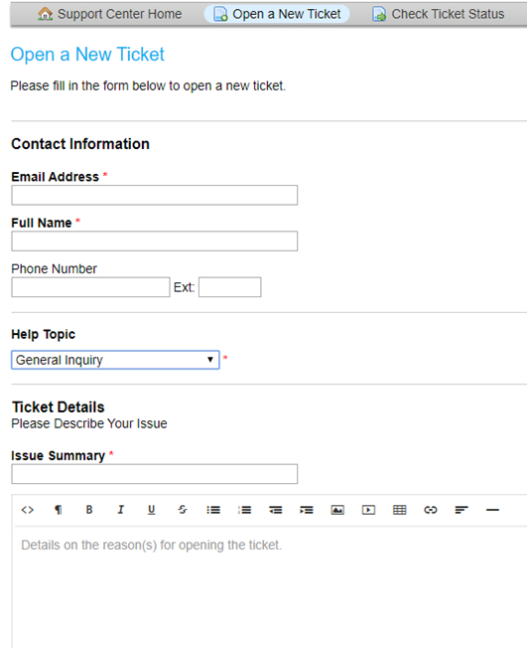
iMIS Food Intranet: action list
Ticket system for
Actions from control rounds
Actions from audits
Actions from consultation
Complaints
copyright www.qassurance.com , +31-10-2004080

Slide 27
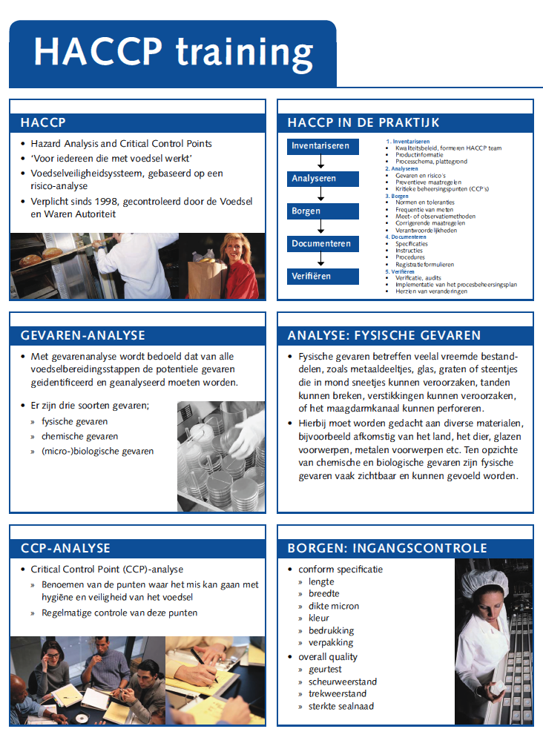
iMIS Food Intranet supporting registration material
copyright www.qassurance.com , +31-10-2004080

Slide 28
iMIS Food
System | Management of
Handbook | the quality manual
Audit | the inspections
SpecCheck | Specifications
Tracking | traceability
Intranet | central documentation
Updates | legislation & hazards
Helpdesk | online daily support
copyright www.qassurance.com , +31-10-2004080

Slide 29
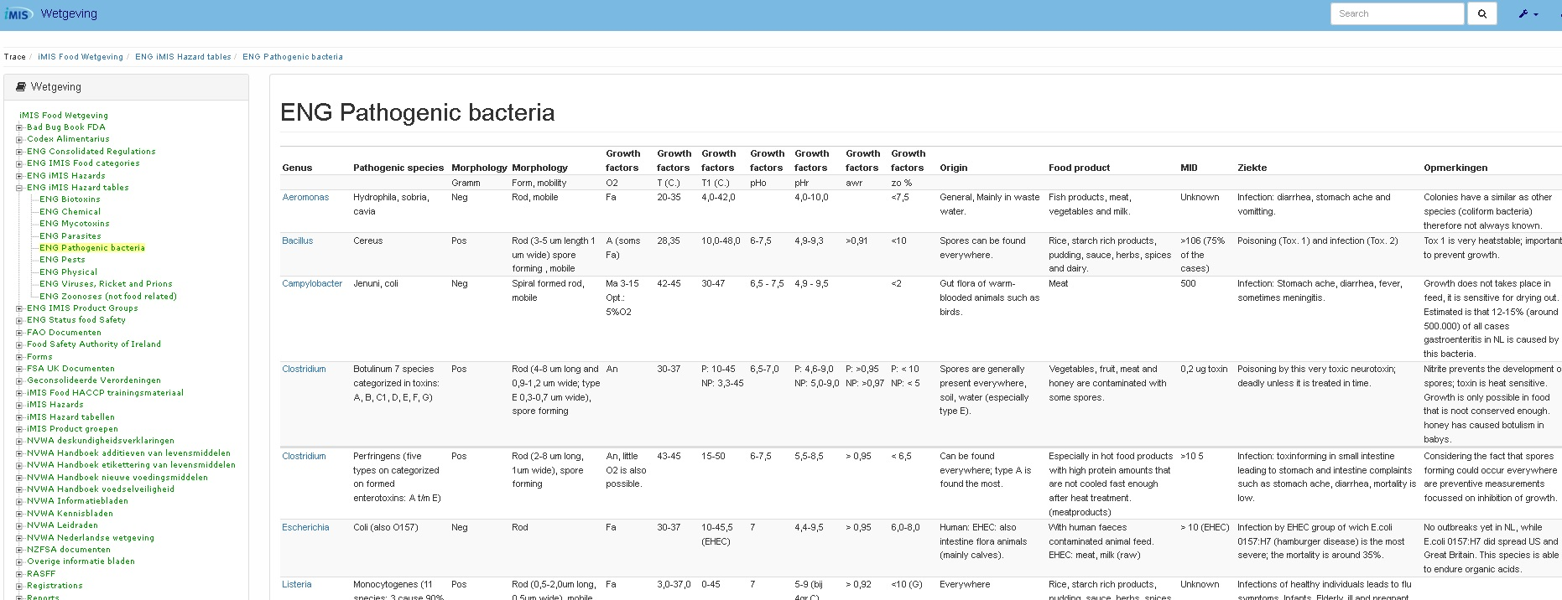
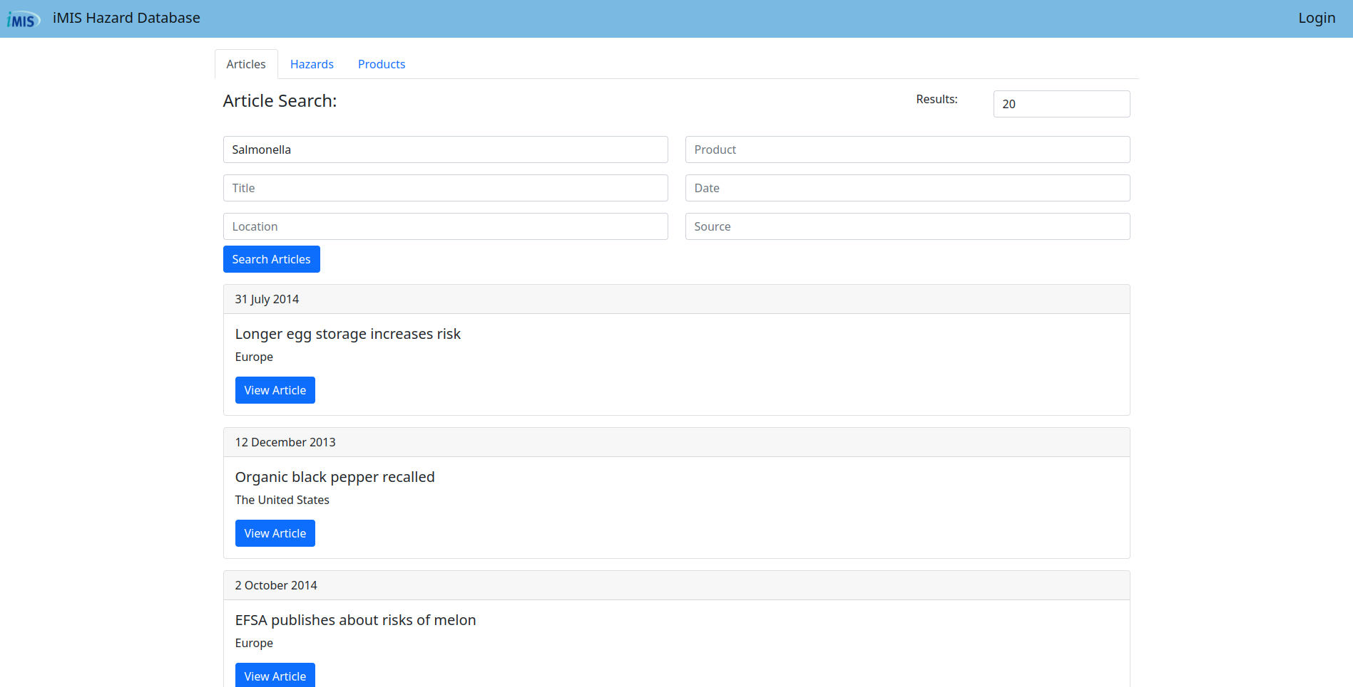
iMIS Food Updates legislation, hazards and standards
Content
Legislation
Standards
Hazards and risks
copyright www.qassurance.com , +31-10-2004080
Notes:
29

Slide 30
iMIS Food
System | Management of
Handbook | the quality manual
Audit | the inspections
SpecCheck | specifications
Tracking | traceability
Intranet | central documentation
Updates | legislation & hazards
Helpdesk | online daily support
copyright www.qassurance.com , +31-10-2004080

Slide 31
iMIS Food Helpdesk the support
Content
Legislation & HACCP study
Quality standards
Inspection rounds
Labelling & Specifications
Available 24 hours a day for recalls
Software
Support in using the software
Remote takeover of the PC
Import and export of data
Company-specific reports
Handheld use, scanning and labelling
copyright www.qassurance.com , +31-10-2004080
Notes:
31

Slide 32
Van Nelle Factory: (Online) information sessions and events

