Slide 1


Slide 2


Part 1: Introduction
Food Safety Compliance
HACCP introduction
Methodology
    Prerequisite program
    Control measures
Good Manufacturing Procedures
HACCP study: specific hazards
HACCP study: decision tree, raw materials and processes
Our company: HACCP
Legislation
    EU regulations & Information sheets & Recall
    Food Safety Authority
Notes:
2

Slide 3
Introduction
Food Safety Compliance
HACCP introduction
Methodology
    Prerequisite program
    Control measures
Good Manufacturing Procedures
HACCP study: specific hazards
HACCP study: decision tree, raw materials and processes
Our company: HACCP
Legislation
    EU regulations & Information sheets & Recall
    Food Safety Authority
Notes:
3

Slide 4
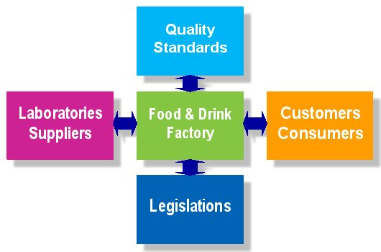
In which field do we operate?
Notes:
4

Slide 5
Food Management:
  Dynamic playing field
  2000 quality requirements
  100 suppliers
  100 customers
  100 employees
  400 legislative changes
Notes:
5

Slide 6
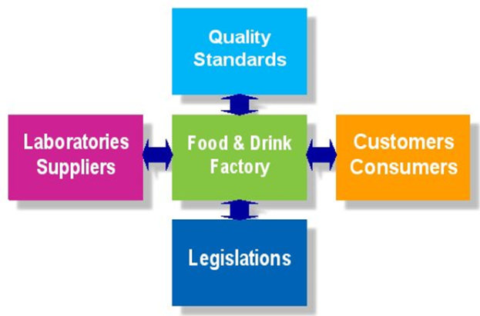
Legislation: HACCP
Hazard analysis
Overview of pathogens, chemical hazards
  Pathogenic bacteria
  Mycotoxins
  Other biotoxins
  Viruses, rickets and prions
  Parasites & Pests
  Chemical & Physical
  Zoonoses & Extensive Toxins
  Spoilers
Hazard analysis
  Control of raw material hazards
  Process hazard management
  HACCP-team
  Decision tree
  Control measures

Slide 7
Introduction
Food Safety Compliance
HACCP introduction
Methodology
    Prerequisite program
    Control measures
Good Manufacturing Procedures
HACCP study: specific hazards
HACCP study: decision tree, raw materials and processes
Our company: HACCP
Legislation
    EU regulations & Information sheets & Recall
    Food Safety Authority
Notes:
7

Slide 8
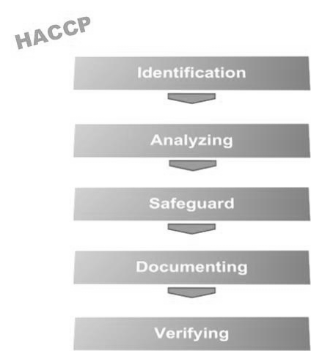

Slide 9

Analysis:
Physical hazards
Physical hazards usually involve foreign substances such as metal particles, glass, bones, or stones that can cause cuts in the mouth, break teeth, cause choking, or perforate the gastrointestinal tract.
This includes various materials such as those originating from land, animals, glass objects, metal objects etc. With respect to chemical and biological hazards, physical hazards are often visible and can be felt.

Slide 10
Analysis:
Chemical hazards
Chemical hazards include substances that adversely affect health, because they are acutely dangerous or because they cause damage in the long term. The following types of substances should be considered:
    Substances of natural origin,
    (Agricultural) chemicals,
    Environmental pollution.

Slide 11
Analysis:
Biological hazards
When making an inventory of the biological hazards, it is important to identify those factors and microorganisms that play a role in the occurrence of food spoilage, food infection, and food poisoning. The presence and occurrence of microorganisms in food is determined by three factors, namely:
    Factors determining the “introduction” (sources).
    Factors influencing the growth of microorganisms (conditions).
    Factors by which microorganisms are killed (processes).

Slide 12
Biological hazards:
Bacteria
Examples of infectious pathogens: Campylobacter jejuni, Salmonella, Shigella, Escherichia coli, Vibrio cholerae, Vibrio parahaemolyticus, Listeria, etc.
Examples of toxigenic pathogens: Bacillus cereus, Clostridium botulinum, Clostridium perfringens, Staphylococcus aureus, fungi, etc.

Slide 13
Biological hazards:
Viruses
Small round structured viruses (SRSV’s) appear to be the main cause of food-related viral infections.
The food-related infections are mainly caused by people contaminating ready-to-eat food.

Slide 14
Introduction
Food Safety Compliance
HACCP introduction
Methodology
    Prerequisite program
    Control measures
Good Manufacturing Procedures
HACCP study: specific hazards
HACCP study: decision tree, raw materials and processes
Our company: HACCP
Legislation
    EU regulations & Information sheets & Recall
    Food Safety Authority
Notes:
14

Slide 15
Methodology
Firstly, the prerequisite program (PRP) must be completed.
The entire food safety plan is based on a prerequisite program, followed by HACCP-based procedures.
In the HACCP study, specific hazards are related to the raw materials and the processes.
For the purpose of clarifying generic hazards that are reduced to an acceptable level by means of the PRP, an additional control measure table has been drawn up to also operationalize the PRP in procedures.
This is not necessary according to the principles of HACCP.
The hazard analysis is based on the Codex Alimentarius, scientific documents and legal texts.
The hazard analysis has been drawn up per process step and per product (raw material, admixture, end products). This involved looking at microbiological, chemical, and physical hazards. All this according to the likelihood and consequence principle.

Slide 16
Prerequisite program
Prerequisite program
Reference: Codex Alimentarius, ‘General Principles of Food Hygiene’ CAC/RCP 1-1969, Rev. 3, 1997, Amended 1999.

Slide 17
Prerequisite program (1/6)
2. Establishment: design and facilities
2.1.1 Establishment
2.1.2 Equipment
2.2 Premises and rooms
2.2.1 Design and layout
2.2.2 Internal structures and fittings
2.2.3 Temporary / mobile premises, vending machines
2.3.1 General
2.3.2 Food control and monitoring equipment
2.3.3 Containers for waste and inedible substances
2.4.1 Water supply
2.4.2 Drainage and waste disposal
2.4.3 Cleaning
2.4.4 Personnel hygiene facilities and toilets
2.4.5 Temperature control
2.4.6 Air quality and ventilation
2.4.7 Lighting
2.4.8 Storage

Slide 18
Prerequisite program (2/6)
3.1 Control of food hazards
3.2.1 Time and temperature control
3.2.2 Specific process steps
3.2.3 Microbiological and other specifications
3.2.4 Microbiological cross contamination
3.2.5 Physical and chemical contamination
3.3 Incoming materials requirements
3.3.1 Specifications
3.3.2 Control at reception
3.3.3 Stock rotation
3.4 Packaging
3.4.1 Design and materials
3.4.2 ‘Food-grade’ materials and gases
3.4.3 Reusable packaging
3.5 Water
3.5.1 Water in contact with food

Slide 19
Prerequisite program (3/6)
3.5.2 Reuse of re-circulated water
3.5.3 Reuse of re-circulated, non-treated water
3.5.4 As an ingredient
3.5.5 Ice and steam
3.6 Management and supervision
3.6.1 Type of control and supervision
3.6.2 Knowledge required
3.7 Documentation and records
3.7.1 Retain records
3.7.2 Effectiveness and credibility
3.8 Recall procedures
3.8.1 Effective procedures
3.8.2 Tracing & Tracking
3.8.3 Destroy or reprocess

Slide 20
Prerequisite program (4/6)
4 Establishment: maintenance and sanitation
4.1 Maintenance and cleaning
4.1.1 General
4.1.2 Cleaning procedures and methods
4.2.1 Specifications
4.2.2 Monitoring and verification
4.3 Pest control
4.3.1 General
4.3.2 Preventing access
4.3.3 Harborage and infestation
4.3.4 Monitoring and detection
4.3.5 Eradication
4.4 Waste management
4.4.1 Removal, storage
4.4.2 Cleaning
4.5 Sanitation systems
4.5.1 Monitoring
4.5.2 Verification
4.5.3 Review

Slide 21
Prerequisite program (5/6)
5 Establishment: personal hygiene
5.1 Health status
5.1.1 Access prevention
5.2 Illness and injuries
5.2.1 Conditions to be reported
5.3 Personal cleanliness
5.3.1 Protective clothing
5.3.2 Cuts and wounds
5.3.3 Washing hands
5.4 Personal behavior
5.4.1 Smoking, eating, sneezing
5.4.2 Jewelry
5.5 Visitors
5.5.1 Cleanliness and behavior

Slide 22
Prerequisite program (6/6)
6 Transport
6.1 General
6.2 Requirements
6.3 Use and maintenance
7 Product information and consumer awareness
7.1 Batch identification
7.2 Product information
7.3 Labelling
7.4 Consumer education
8 Training
8.1 Awareness and responsibilities
8.2 Training programs
8.3 Instruction and supervision
8.4 Refresher training

Slide 23
Prerequisite program Example
Standard | Standard text | Included in | Argumentation
2. Furnishing: design and facilities
2.1.1 Device | 2.1.1.1 Establishments may not be located in places where it is clear that they pose a threat to food safety. In particular, establishments will normally be located at a distance from: • Contaminated sites and industrial activities that pose a serious risk of contamination of foodstuffs. • Areas exposed to flooding unless adequate safety measures have been taken. • Areas contaminated by pests or plant diseases, or where this is likely to be the case. • Sites whose waste, both solid and liquid, cannot be adequately removed | Environment | The company is so structured that the environment does not adversely affect the safety of products, buildings and personnel
2.1.2 Equipment | 2.1.2.1 The equipment/material shall be arranged in such a way that it can be: • Used and cleaned effectively. • Functions in accordance with the intended use. • Enables good hygienic application, including monitoring. |  | Meets the set requirements. All the material is easy to clean and intended for use. This is assessed during the internal audit and quick scan.
2.2 Buildings and premises
2.2.1 Design and layout | 2.2.1.1 Where appropriate, the indoor design and layout shall allow for good hygiene practices, including protection against harmful cross-contamination/contamination |  | Meets the set requirements. This is assessed during the internal audit and quick scan.

Slide 24
Prerequisite program Controls
The PRPs list shows various possible hazards and points of attention. The applicable aspects are governed by procedures, instructions and the associated measures. Based on the fact that they originate from the PRPs or that the PRPs have given rise to the preparation of these measures, they are not guided by the decision tree. The following measures are in force within our company and are assessed at least annually or in the event of a new risk or an incident with food safety or food defense.
Danger from PRP | Control by | Standard | Action in case of deviation | Procedure /Instruction
Cross-contamination with pathogens towards products with a risk of disease. | Proper personal hygiene prevents cross-contamination. | Everyone must comply with the applicable regulations. | Re-instruction staff, address staff. Block products at extremes. | Procedure: hygiene Instruction: hygiene control
Cross-contamination with pathogens or dangerous substances due to poor industrial hygiene in the broad sense of the word with a risk of disease. | By monitoring company hygiene, cross-contaminations are prevented. | Everyone must comply with the applicable regulations. | Re-instruction staff, address staff. Block products at extremes. | Procedure: industrial hygiene Instruction: hygiene control
Pest droppings, food, etc. Pests can be carriers of pathogens with a chance of disease. | Good pest control, entrance control and weekly check for accumulation of waste /food. | Not unanimated. | Additional control applications. Instruction staff. Structural adjustments. | Procedures: pests and entrance controlIns tructions: hygiene control, pest control and entrance control

Slide 25
Good Manufacturing Procedures
Covid 19
Complaints
Documentation
Education and training
Entry Check
Cleaning
Allergen managementForeign Materials
Glass and hard plastic
Labeling and packaging check
Maintenance
Pest Control
Recall
Traceability
Visitors
Food Defense

Slide 26
Company Protocol for Coronavirus COVID-19
  Measures to prevent the spread of coronavirus
  If you have a cold, cough, sore throat, or fever, stay home. Avoid social contact.
  Keep an eye on your health, if you get a cold or increase to 38 degrees Celsius, you stay home to recover from the sickness and to not infect others.
  You can call the doctor if you get a fever (more than 38 degrees Celsius) and cough or if your breathing becomes increasingly difficult.
  If you have been in contact with people who are infected or have been in a risk area, then stay extra alert.
  When can you go back to work: If you have the above complaints, you should stay at home until you have one day without coughing and you don’t have a fever. If family members still have complaints, you may return to work if you have not coughed for one day and have no fever.
  Even if you have no complaints, work from home as much as possible or try to spread your working hours.
  Do not attend trade fairs, events, gathering, or other places where many people gather.
  Visitors to our company are prohibited, visitors are only allowed for urgent or emergency situations.
  Consultations and meetings held by telephone, video calling, and etc. as much as possible. This also applies to internal consultation or otherwise only with a small group with due observance of the hygiene measures below.
  Hygiene measures to be observed:
  Wash your hands regularly and thoroughly with water and disinfectant soap and / or gel.
  Dry well with paper (on a roll or towels) or air dryer. These dryers must be thoroughly cleaned and disinfected at least every day.
  Cough and sneeze into the inside of your elbow.
  Use tissue paper and wash your hands afterwards.
  Don’t shake hands.
Good Manufacturing Procedures

Slide 27
Complaints
Anyone dissatisfied with our goods or services has the right to complain. Complaints might come from our consumers or from inside. Food safety complaints are documented.
We have a duty to resolve all complaints received, within reason.
All complaints must be treated seriously.
All complaints are recorded on the form.
Complaints must, if possible, be dealt with within 5 working days.
If possible, preventive and / or corrective measures should be taken to prevent recurrence.
The damage suffered must be compensated as much as possible in the case of valid complaints.
All complaints shall be in writing and / or handled by telephone with the complainant.
All complaints will be used for trend analysis.
If it appears from the trend analysis that structural problems are occurring, then measures will be taken in order to resolve these structural complaints. This may be through changes in process and / or product.
A root cause analysis must only be conducted by a significant rise in the total complaints or serious complaints (food safety).
Good Manufacturing Procedures

Slide 28
Documentation
How to record and register is outlined in this step-by- The quality manual is digitally stored in iMIS. Every change is tracked in the system, so it would be easy to compare to earlier versions. Login codes with passwords and authorizations control who can see or edit documents. Daily electronic backups keep papers safe. The following types of documents are included in our digital handbook:
Procedure: Cross-departmental activities are recorded in a procedure. A procedure contains the steps that must be followed by different departments to achieve the desired end result.
Instructions: An instruction states how an action must be carried out within the department.
Form: A form is intended as an information carrier and serves as a means of communication between the different department.
Specifications: The determined constants are recorded here. Specifications are intended for reference.
Good Manufacturing Procedures

Slide 29
Education and Training
  Training
  All employees in our organization must have the necessary training, education, or experience. This may be achieved by external or internal training. Management must retrain or educate employees who are not appropriately trained or educated. The training requirement is set annually.
  MIS Audit Control Rounds:
  Once per month the personnel knowledge check is performed to check if all employees have enough knowledge of, among other things:
  Company rules
  Hygiene rules
  HACCP
  Employee health and safety
Good Manufacturing Procedures

Slide 30
Entry Check
  1. Only receive deliveries from approved suppliers.
  2. Only receive products for which approved product specifications are present.
  3. Only receive products signed terms of delivery.
  4. The driver may only load / unload after the means of transport has been registered.
  5. The driver must have clean hands and wear clean clothes.
  6. The driver must comply with the iMIS external rules.
  7. The recipient checks the delivery for:
  a. Order quantity
  b. Temperature (where needed)
  c. Transport conditions
  d. Driver care
  e. Packaging
  f. Labeling
  g. Pests
  8. This is done in accordance with the entry check form.
  9. The temperature is measured with a calibrated thermometer. This thermometer is disinfected before and after use.
  10. All audit findings, corrective actions, and comments must be noted on the entry check form.
  11. The delivery is also assigned a tracking number.
  12. If necessary, a process sample is taken from the delivery and a process sample number is assigned to it.
  13. This procedure also applied to returns (products received by the customer). Only returns from EC approved companies may be received.
  14. This procedure also applies to pre-printed labels. These must be checked against the product specification with each delivery.
  15. This procedure also applies to outsourced production and packaging activities.
  16. This procedure also applies to products stored outside; the must not be affected.
Good Manufacturing Procedures

Slide 31
Foreign material
  Glass, hair, grime, peeling paint, injection needles (meat), insects, and other physical contaminants may contaminate food products. Physical contaminants come from building materials, employees, and badly maintained buildings and equipment. Foreign bodies are all materials that do not naturally belong in food. These foreign bodies in food may not only irritate or repel customers but can also injure humans and pose a health risk.
  Glass, hair, grime, peeling paint, injection needles (meat), insects, and other physical contaminants may contaminate food products. Physical contaminants come from building materials, employees, and badly maintained buildings and equipment. Foreign bodies are all materials that do not naturally belong in food. These foreign bodies in food may not only irritate or repel customers but can also injure humans and pose a health risk.
Good Manufacturing Procedures

Slide 32
Cleaning
  To prevent the accumulation of, and cross infection with, filth and micro-organisms, good cleaning and disinfection is of great importance. Most cleaning operations are outsourced to a specialized company to ensure the proper cleaning and disinfection. Small daily cleaning operations are conducted by our own staff. There is an agreement made with the cleaning company, where our requirements are recorded. The employees of the cleaning company must hold to our hygiene rules. All employees of the outside company have:
  Health declaration;
  Signed hygiene requirements;
  Proof of qualification;
  Responsibilities.
  Of the used cleaning products and disinfectants, the necessary specifications are available (MSDS and product information pages with intended use, recommended dosage, pH, and etc.)For cleaning, the departments must be broom clean and the machines dismantled. All production areas are cleaned and disinfected according to fixed schedules. These schedules are recorded in the specifications. The cleaning rules for processing equipment, food contact surfaces, and room cleaning inside high care / risk areas must contain minimal:
  Responsible;
  Item / area that must be cleaned;
  Cleaning frequency;
  Method of cleaning, including dismantling equipment on which cleaning activities must be performed.
  Cleaning solutions and concentrations;
  Cleaning materials;
  Cleaning record and cleaning verification.
Good Manufacturing Procedures

Slide 33
Allergen Management
  Cross-contamination of allergens or unintended presence of allergens (not declared on the label) can be caused by, for example:
  Presence in raw material, while this is not mentioned in the raw material specification.
  Use of the wrong recipe or incorrect execution of the recipe.
  Incorrect labelling or use of the wrong label or packaging.
  Inadequate cleaning.
  Wrong planning sequence.
  Cross-contamination by employees (hands, clothing, footwear).
  Broken or open the packaging.
  Accumulation via aids, equipment, machines, internal means of transport, crates, buckets, shovels, measuring instruments, etc.
  Accumulation through the air (including ventilation system) or water.
  Accumulation via tools of maintenance technician.
  With the risk analysis about cross-contamination or carry-over of allergens, the account is taken of:
  the physical state of the allergens (for example, in powder form, sticky substance, or particle size).
  potential places in the process where cross-contamination can occur.
Good Manufacturing Procedures

Slide 34
Glass and hard plastic
Consumption of products containing glass shards or hard plastic might result in injury. Our organization identifies this physical danger from other physical hazards by using the glass method and the iMIS Audit. The product may include numerous types of glass..
The measures taken to prevent glass breakage are:
Covering the fluorescent lights;
Covering the windows with foil;
Keep as much glass and hard plastic out of the production areas as possible;
Checks via iMIS Audit patrol.
Good Manufacturing Procedures

Slide 35
Labeling and packaging check
  The check includes checking:
  The assigning of the correct packaging material, that the correct packing material is at the packing machine for immediate use and check, with preprinted packaging material, that only the properly printed packaging materials are present at the correct packaging machine. that when a product is changed, the packaging material is also removed from the line, so that only the packaging material that is used is present at the line. These checks are registered.
  The check is carried out:
  At the start of the packaging;
  During packing;
  When changing batches of packaging materials;
  At the end of every production.
  The check also includes a verification of whether any printing that takes place during the packaging process is correct. Possible prints are:
  Date coding
  Batch coding
  Quantity indication
  Pricing information
  Bar code
  Country of origin
  Allergens
Good Manufacturing Procedures

Slide 36
Maintenance
For all the processes to proceed properly, maintenance is essential.
Maintenance is in the form of both preventative maintenance and adhoc maintenance:
Preventive maintenance: lubricate bearings, small turn machines.
Adhoc maintenance: immediately necessary repairs
Preventative maintenance is recorded in a schedule. Maintenance through external parties is laid down in the contracts. Maintenance on new machines is predetermined by the validation. In all cases it applies that maintenance takes place outside production hours as much as possible. When maintenance must be performed during production, possible product cross contamination must be considered. All maintenance performed is recorded, at minimum:
Committed maintenance;
Reason for maintenance;
Reason for failure;
Taken measures;
Any emergencies during maintenance.
Good Manufacturing Procedures

Slide 37
Pest Control
Pests can pose a threat to the safety of our products. In order to prevent pests, we use an external specialist company. There are also various internal controls in place to prevent potential contamination with pests. The frequency of the check is based on the risk. The plan is revised yearly or in the case of an infestation or significant changes in the building, process, product, or surroundings.
Outsourced Pest Control: We have outsourced pest control to a specialist company. They possess the necessary expertise for the pest control to work properly and must comply with all relevant legislation regarding training and registration of their activities and competences.
Internal Pest Control: To avoid pests there are various internal controls in place. Entry control: By entry control, our products are examined for possible pests. If pests are present, the delivery will be refused. Hygiene Monitoring: During the various checks in the company, we looked at:
The presence of excrement and pests.
Dirt accumulation.
Possible shelters by incorrect storage.
Structural state and possible cracks to the outdoors.
Good Manufacturing Procedures

Slide 38
Recall
Recall
It is essential to strictly follow this recall procedure in case of calamities (illness, death of customers, safety aspects).
Report from the customer
If it appears that someone reports sick customers or the death of customers, the person must immediately transfer to the quality service. When internal abnormalities are found, this is taken to the quality service. If there is no answer, always contact the management.
Good Manufacturing Procedures

Slide 39
Traceability
Traceability applies to used raw materials, additives, end products, packaging materials, and rework i.e., waste and disapproval. This also applies to products used for product development and possible test products. According to the General Food Law, it is required for each foodstuff business’ product to be traceable. In the Guidance (Article 18) it is stated that the company must know which supplier delivers / has delivered what raw materials, including quantity and delivery days. The company must also know which customer received what product and how much. Besides the required traceability from the General Food Law, we conform to the tracing requirements from the certified standards. The actual operation of this system is described in the tracing test report. The full tracing can be complete in 4 hours.
Good Manufacturing Procedures

Slide 40
Visitors
It is forbidden for unauthorized people to enter the production areas. People with permission (visitors) must adhere to the company rules. To this end, they must be kept under supervision and sign in. Visitors are signed in with the registration form (visitors list).
Visitors that have been in contact with, or suffer from, contagious diseases or other sickness that post a threat to food safety may not enter the production areas.
Visitors are not allowed to enter the production area(s) without overclothes and must have at least:
Wear a white overcoat (may also be a new plastic / disposable one);
Wear a hat that covers all hair;
Wear blue shoe protectors (unless visitors walk through the sole cleaner) or footwear provided by the company;
Take of jewelry and watches;
Wash and disinfect hands.
Good Manufacturing Procedures

Slide 41
Food Defense
Appropriate measures have been taken in our company for food defense. With the company security procedure, recall procedure, and HACCP team sessions we are continuously prepared and ready for food defense. In the event of sabotage, evacuation, etc. the following points direct our company:
Management
Human factors
  Employees
  The Public
Business operations
Prerequisite program

Slide 42
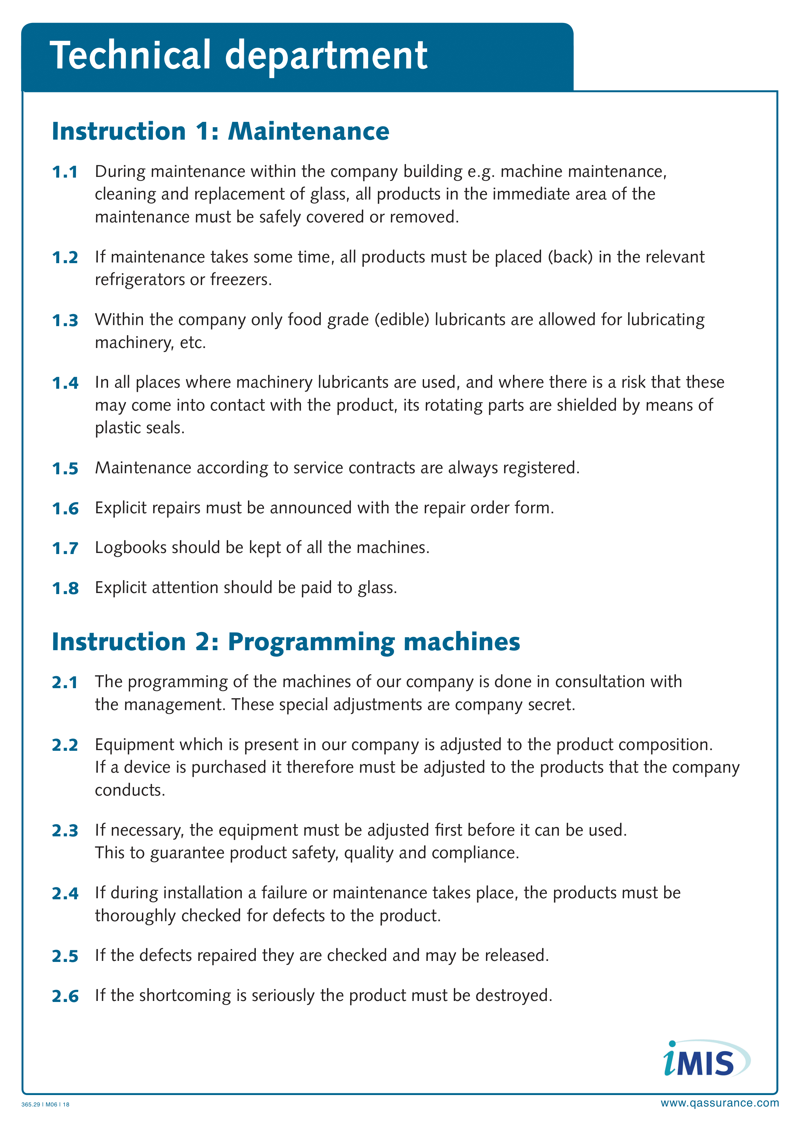
Good Manufacturing Procedures
Company signs

Slide 43
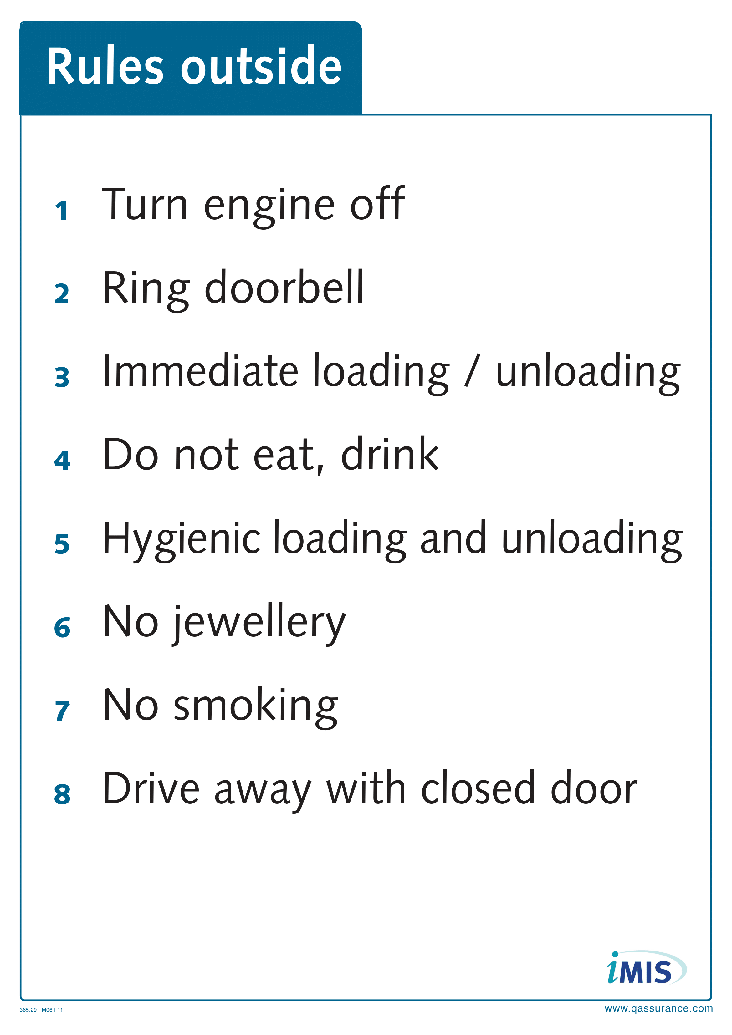
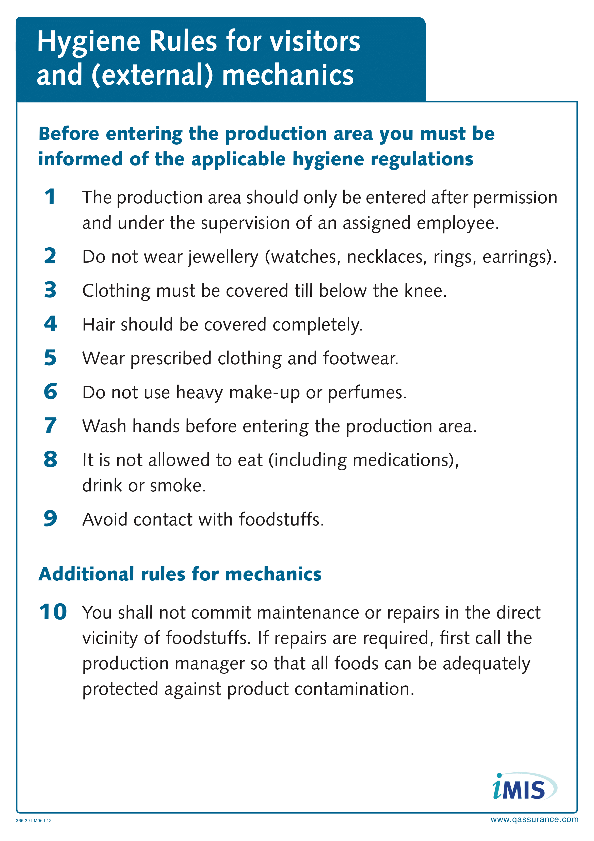
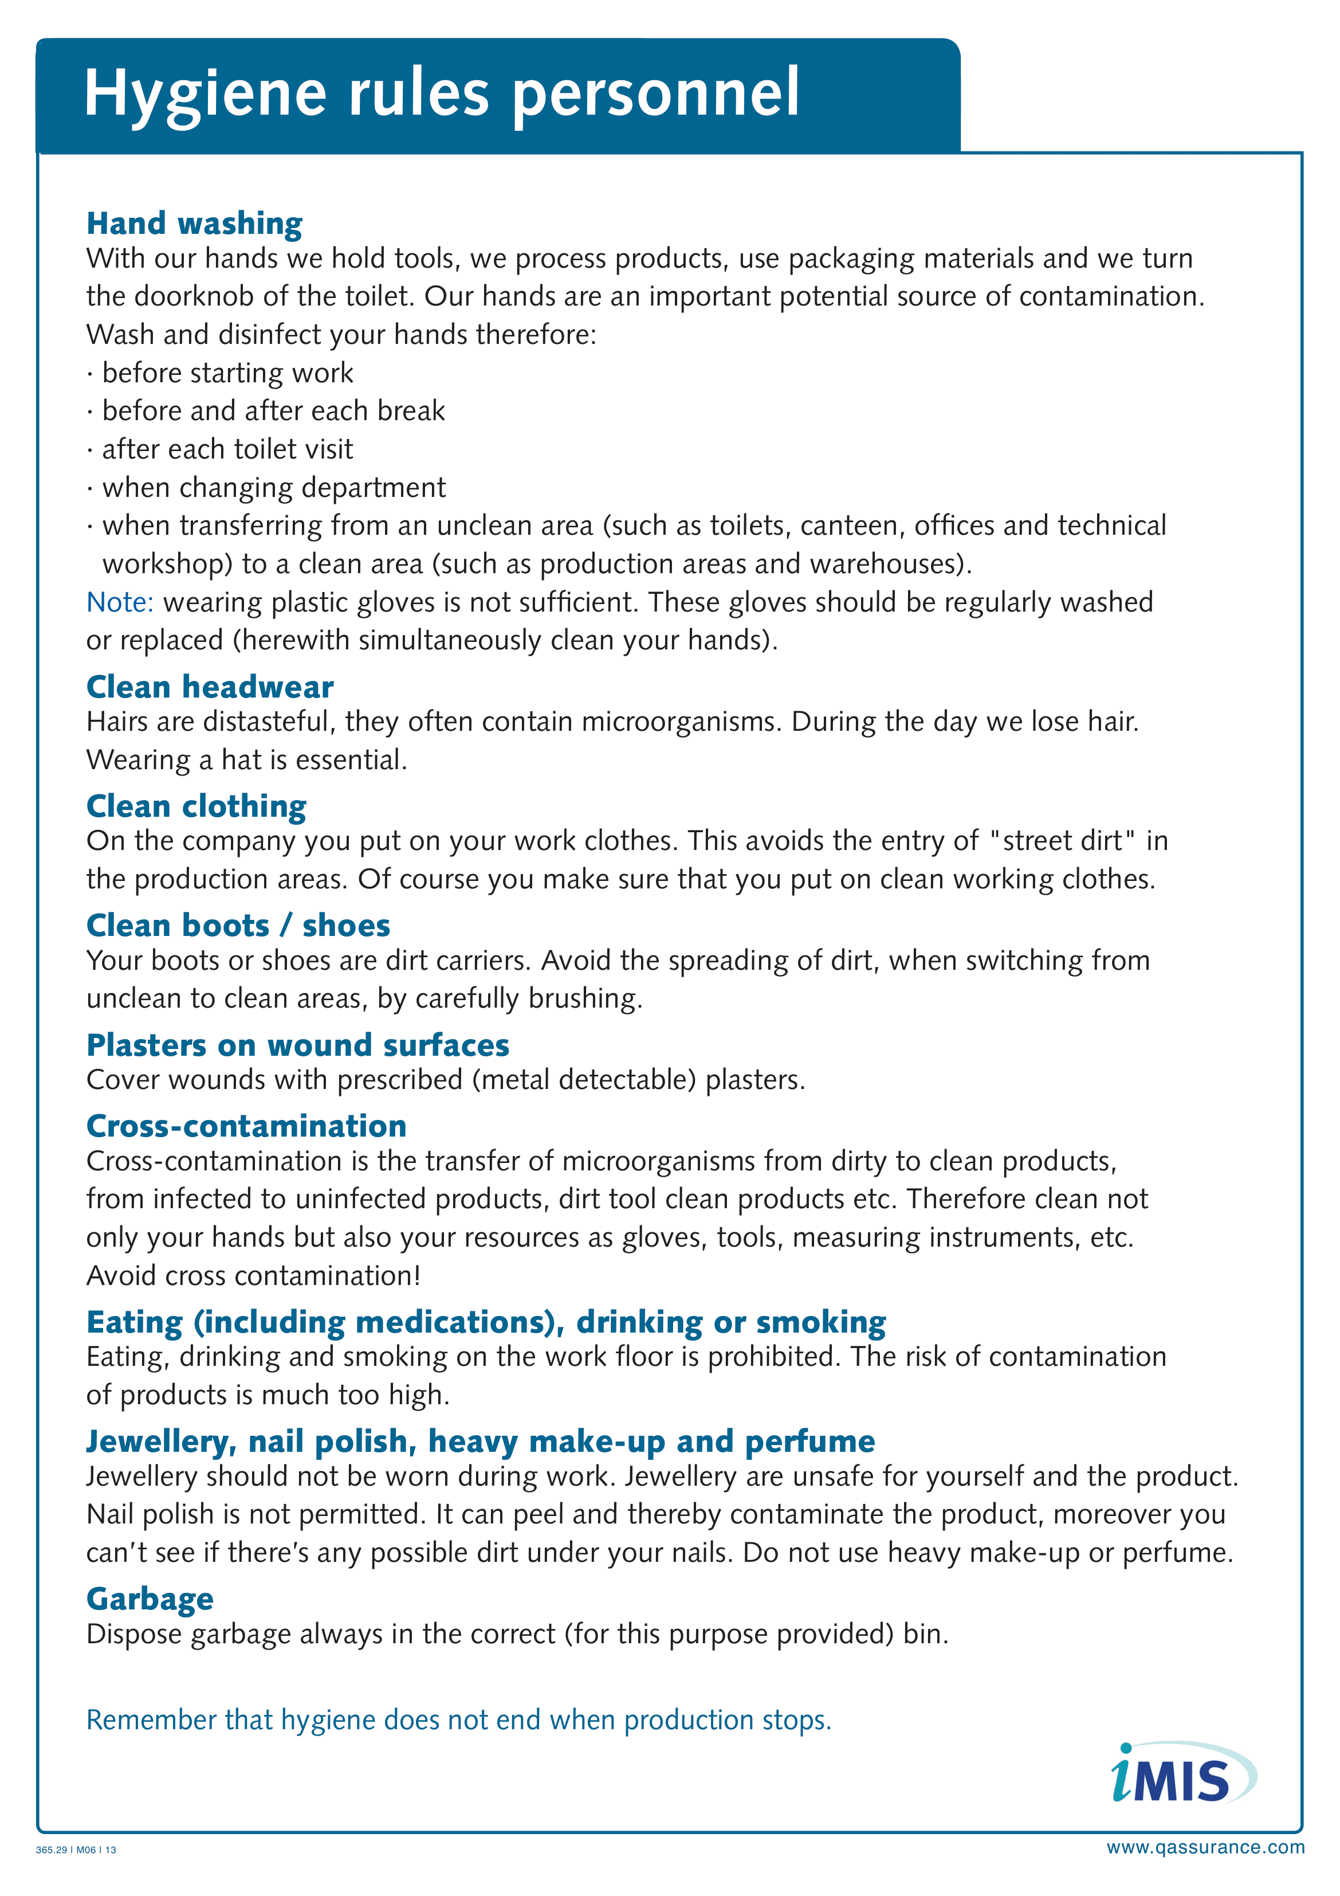
Good Manufacturing Procedures

Slide 44
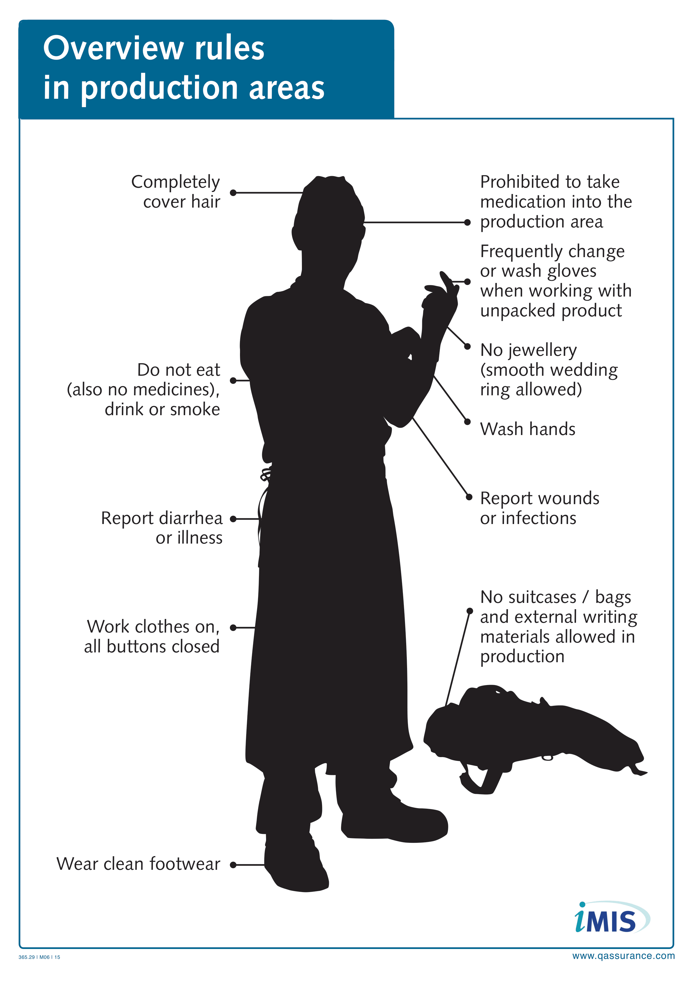
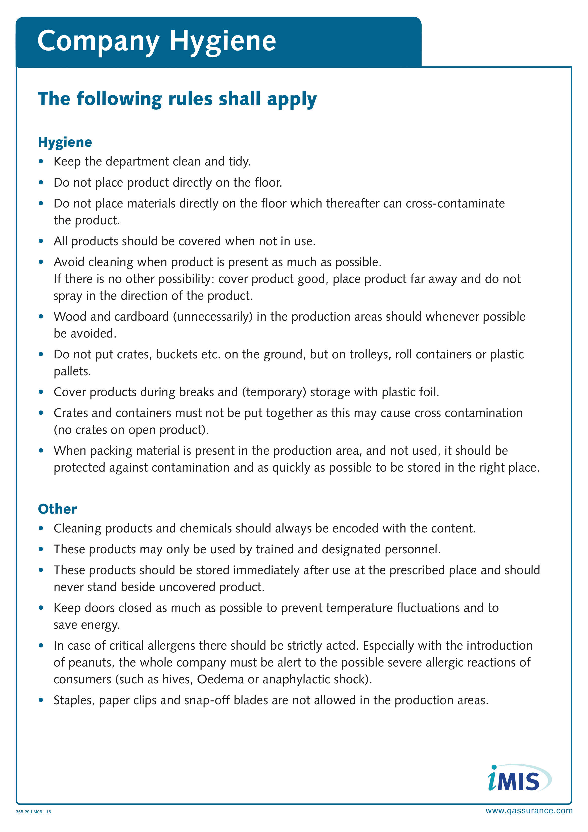
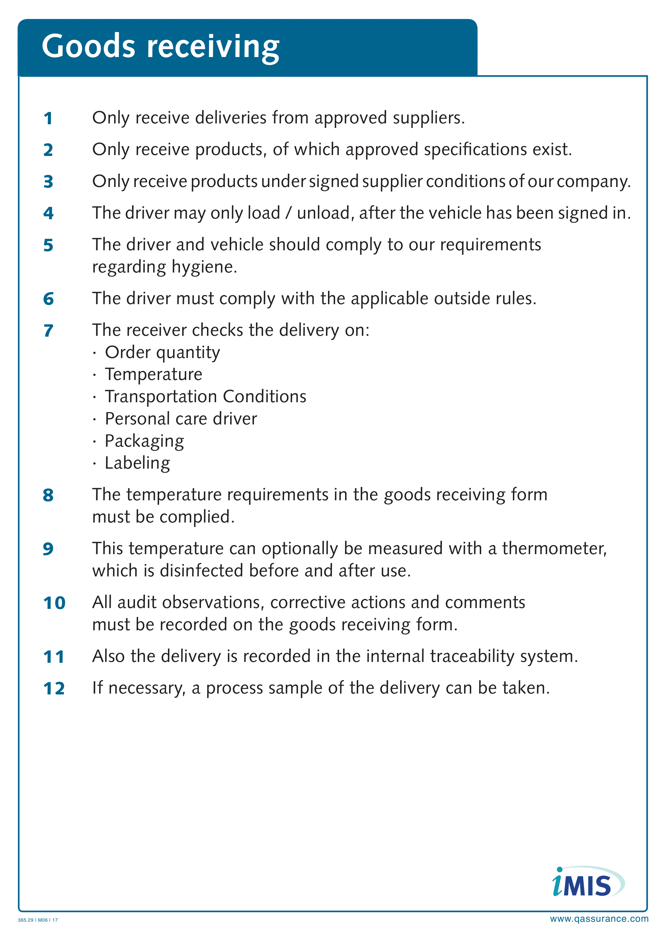
Good Manufacturing Procedures

Slide 45
Our company
Question 1: How does the Prerequisite program look like for our company?

Slide 46
Methodology specific hazards
In the HACCP study, specific hazards are related to the raw materials and the processes.
The hazard analysis is based on the Codex Alimentarius, scientific documents and legal texts.
The hazard analysis has been drawn up per process step and per product (raw material, admixture, end products). This involved looking at microbiological, chemical and physical hazards. All this according to the likelihood x consequence principle.

Slide 47
Introduction
Food Safety Compliance
HACCP introduction
Methodology
    Prerequisite program
    Control measures
Good Manufacturing Procedures
HACCP study: specific hazards
HACCP study: decision tree, raw materials and processes
Our company: HACCP
Legislation
    EU regulations & Information sheets & Recall
    Food Safety Authority
Notes:
47

Slide 48
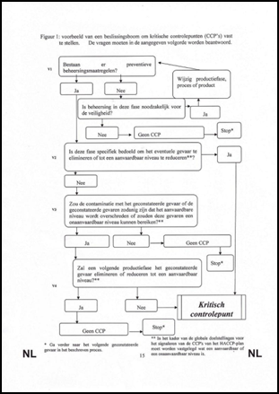
HACCP study: specific hazards
Hazard analysis
Overview of pathogens, chemical hazards
  Pathogenic bacteria
  Mycotoxins
  Other biotoxins
  Viruses, rickets and prions
  Parasites & Pests
  Chemical & Physical
  Zoonoses & Extensive Toxins
  Spoilers
Hazard analysis
  Control of raw material hazards
  Process hazard management
  HACCP-team
  Decision tree
  Control measures
Specific hazards: Codex approach
  Raw materials and info sheet 64/65/85
  Processes
HACCP approach validated weekly in audits and part of the iMIS Food Updates.

Slide 49
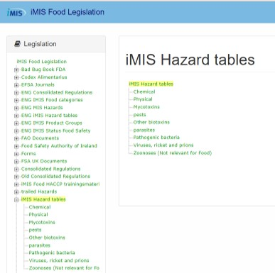
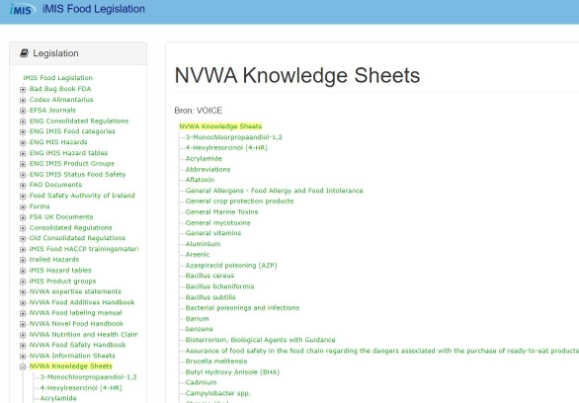
HACCP study: specific hazards background information

Slide 50
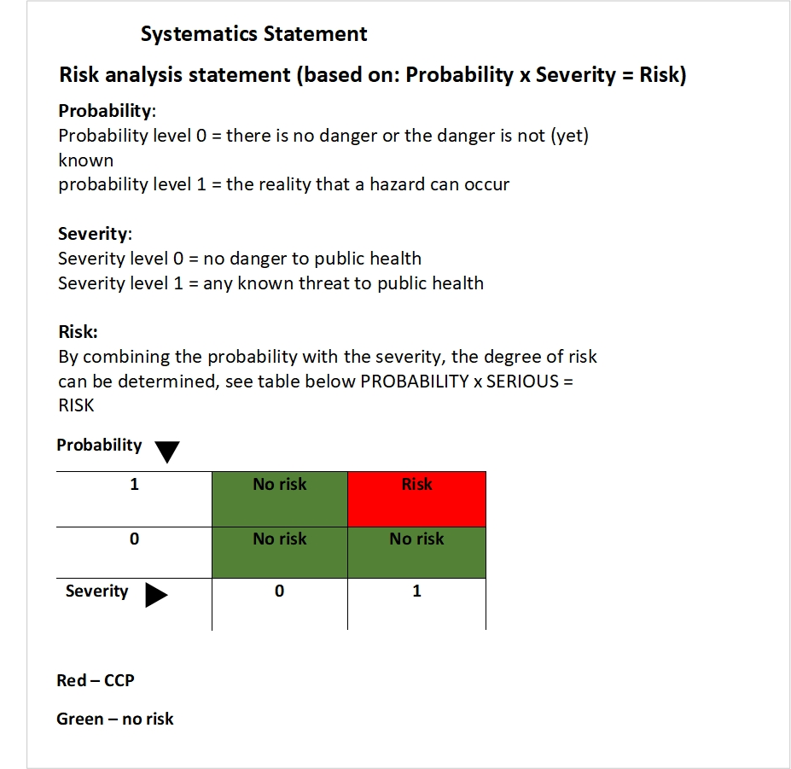
Risk determination method

Slide 51
Introduction
Food Safety Compliance
HACCP introduction
Methodology
    Prerequisite program
    Control measures
HACCP study: specific hazards
HACCP study: decision tree, raw materials and processes
Our company: HACCP
Legislation
    EU regulations & Information sheets & Recall
    Food Safety Authority
Notes:
51

Slide 52
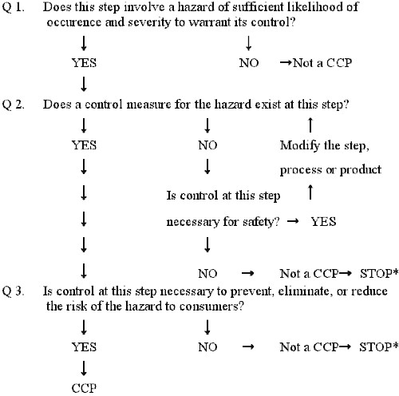
Decision tree

Slide 53
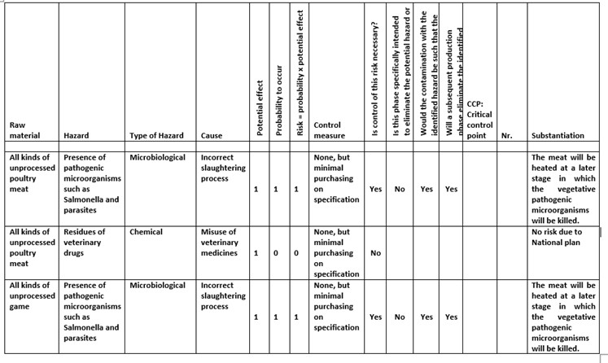
HACCP study: raw materials and processes

Slide 54
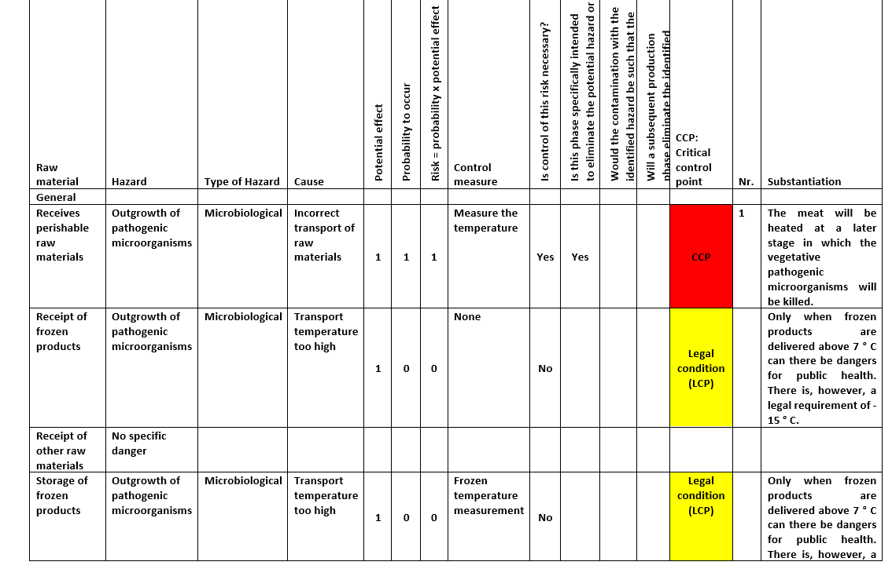
HACCP study: raw materials and processes

Slide 55
Introduction
Food Safety Compliance
HACCP introduction
Methodology
    Prerequisite program
    Control measures
Good Manufacturing Procedures
HACCP study: specific hazards
HACCP study: decision tree, raw materials and processes
Our company: HACCP
Legislation
    EU regulations & Information sheets & Recall
    Food Safety Authority
Notes:
55

Slide 56
Our company
Question 2: How does the HACCP study look like for our company?
Question 3: How does the CCP and OPRP monitoring table look like?

Slide 57
Introduction
Food Safety Compliance
HACCP introduction
Methodology
    Prerequisite program
    Control measures
Good Manufacturing Procedures
HACCP study: specific hazards
HACCP study: decision tree, raw materials and processes
Our company: HACCP
Legislation
    EU regulations & Information sheets & Recall
    Food Safety Authority
Notes:
57

Slide 58
Legislation: EU regulations
1990-496 Nutritional information
2002-178 General Food Law
2005-2073 Microbiological criteria
2005-396 Pesticide residues
2006-1881 Contamination of food
2006-1924 Nutrition and health claims
2008-1333 Additives
2008-1334 Aromas
2011-1169 Food information
Notes:
58

Slide 59
Legislation: Info Sheets & Knowledge Sheets
Info Sheets: how to deal with sampling
  Info sheet 64
  Info sheet 65
  Info sheet 85
Knowledge Sheets
  Food allergy and food intolerance
  Bioterrorism, biological agents with guideline
  Contaminants from PVC packaging
  Contaminants from packaging by irradiation
  Paralytic shellfish poisoning (PSP)
  Toxoplasma gondii
  Zoonoses
Notes:
59

Slide 60
Legislation: Recall
2002-178 General Food Law
Article 19: By order of competent authority
BuRO risk assessment
Reporting guide
Issue management
RASFF - Food and Feed Safety Alerts
Notes:
60

Slide 61
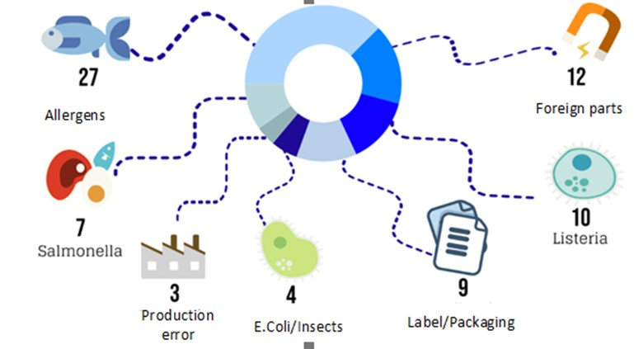
Legislation: Recall (VMT overview 2019)
Notes:
61

Slide 62
Our company
Question 4: What does our Recall procedure look like?
  Does this refer to the reporting guide?
  Does it state when the certifier must be contacted?

Slide 63
Food Safety Authority
1. Tracing
  Properly recording the current method of tracing all normal products as well as any biological flow.
  Describe any missing trace actions in more detail and record them in additional records.
  Method of tracing closed weekly: demonstrably correct.
2. Additives
  Raw materials, Recipes, End products up to date
  2 E-number analysis on this product portfolio
  Keep E-number analysis up to date

Slide 64
Food Safety Authority
3. Microbiology
  Check microbiological plan for legislation.
  Check microbiological plan last year for compliance.
  Carefully implement current year microbiological plan.
4. Listeria
  Demonstrable compliance with info sheet 85 regarding Listeria.
  Analysis of current product portfolio in which FSSP must be substantiated with, among others, why Challenge tests have or have not been carried out.
  Describe the Listeria approach that demonstrably meets the legal requirements.

Slide 65
Food Safety Authority
5. STEC
  5A Using the product portfolio, analyze which raw products to be consumed can have STEC as a problem.
  5B Conform STEC to Food Safety Authority policy and guarantee these products regarding STEC
  5C Info sheet 64 of Food Safety Authority considered for STEC
6. EDP audit
  6A Administrations may be taken without any reason / suspicion
Notes:
65

Slide 66

iMIS Food Security Program Training

Slide 67
Part 2: Contents
Food Safety Compliance
FSSC22000
What should you pay attention to?
FSSC22000, version 5 HLS
QESH standards
HACCP team: tasks
HACCP team: annual reports
Notes:
67

Slide 68
Contents
Food Safety Compliance
FSSC22000
What should you pay attention to?
FSSC22000, version 5 HLS
QESH standards
HACCP team: tasks
HACCP team: annual reports
Notes:
68

Slide 69
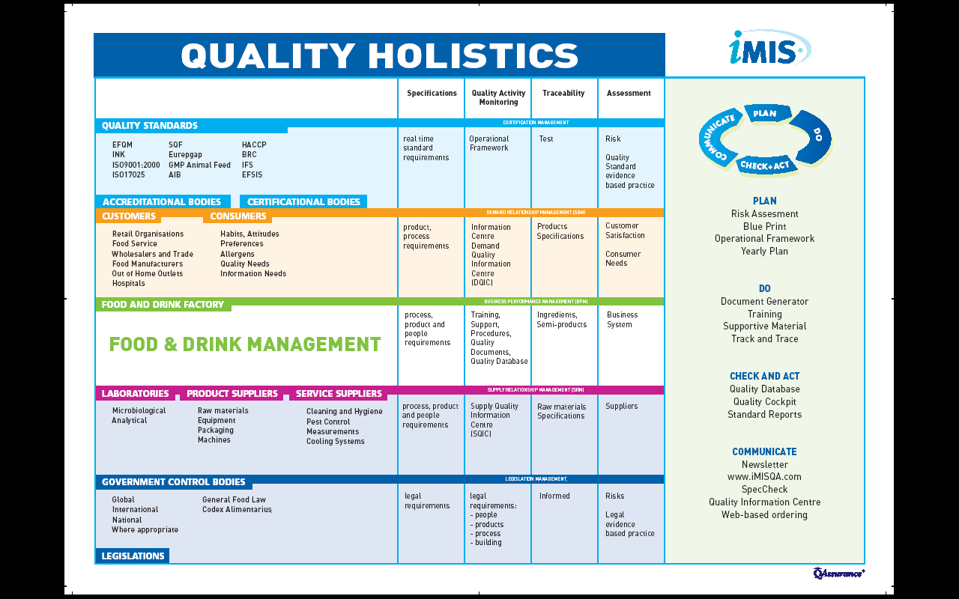
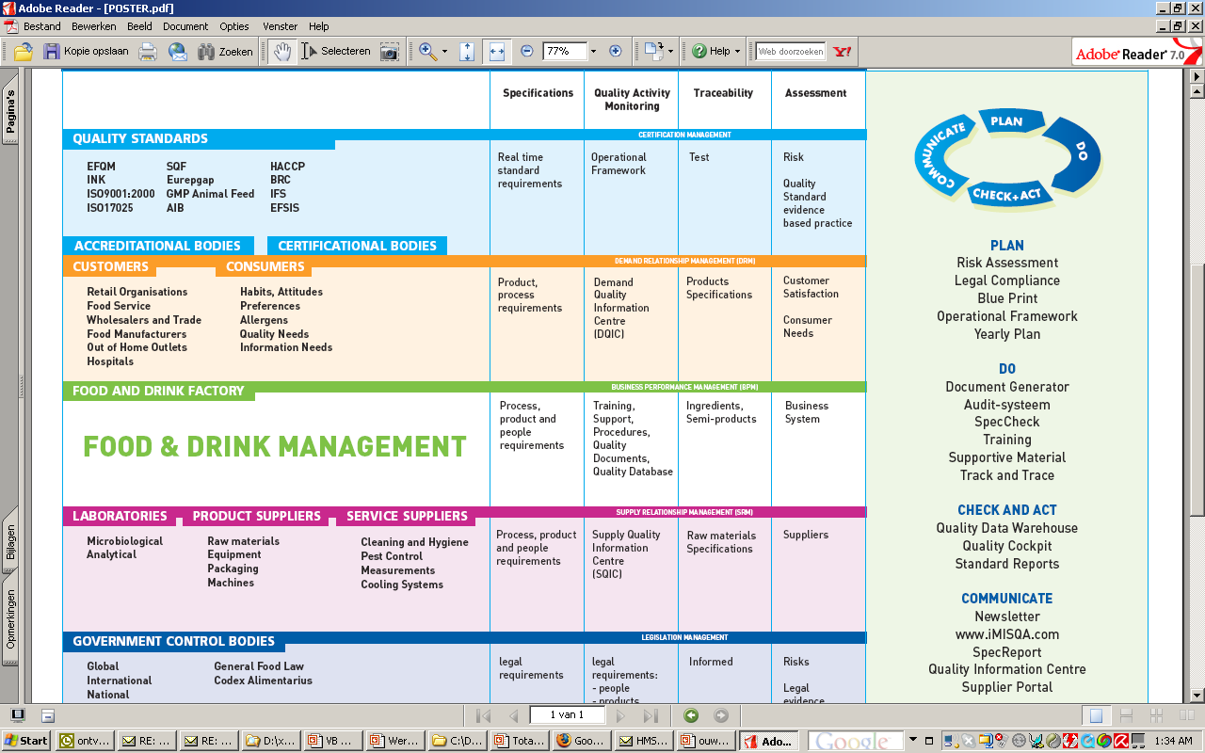
Notes:
69

Slide 70
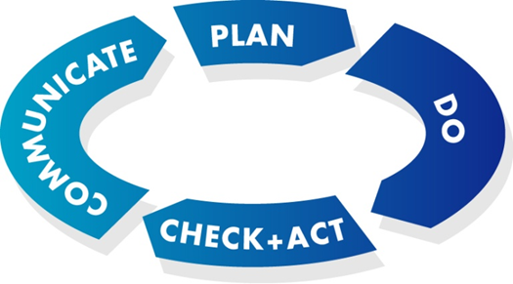
iMIS Food content & software
iMIS: integral Management & Information System
Food: for real-time management of food safety
Content
  Operational framework for food safety
  Food Safety standards: HACCP, FSSC22000, BRC, IFS
  Extra for QESH: ISO9001, 14001, 26000
Software
  User-friendly
Notes:
70

Slide 71
Food Management:
  Dynamic playing field
  2000 quality requirements
  100 suppliers
  100 customers
  100 employees
  400 legislative changes
Notes:
71

Slide 72
Standards
Quality:
  BRC
  IFS
  FSSC22000
  SQF
  Dutch HACCP
  Quality marks such as HALAL, SKAL, UTZ
Environment: ISO14001
Occupational health and safety: ISO45001
Corporate Social Responsibility:
  CSR Performance Ladder (ISO26000)
Notes:
72

Slide 73
Standards
Food Production parameters
  Product
  Process
  Person
  Production area
Food Defense
Food Fraud
Not just for production: traders too
  HACCP of the entire chain
Retail customer? 2 CI’s and 2 Certificates!
ZZP auditors…
SKAL <-> Food Safety Authority <-> EDP audit
Notes:
73

Slide 74
Standards in practice
Most food companies are BRC, IFS, or FSSC22000 certified
What are the differences and similarities between these standards?
How do you set up your quality system, documentation, and compliance?
How do you deal with difficult audit situations?
As a company, can you cancel the audit yourself if you want to?
Based on more than 500 audits, knowledge is transferred about how you can best demonstrably meet the quality standards
How are the certification bodies organized?
Expand the food safety system to ISO9001, ISO14001 and the CSR performance ladder

Slide 75
Contents
Food Safety Compliance
FSSC22000
What should you pay attention to?
FSSC22000, version 5 HLS
QESH standards
HACCP team: tasks
HACCP team: annual reports
Notes:
75

Slide 76

FSSC22000
FSSC 22000 stands for Food Safety System Certification 22000 and is an internationally recognized form of demonstrable food safety.
The FSSC 22000 has its origins in the Codex Alimentarius and is a standard developed by the Foundation for Food Safety Certification
The FSSC 22000 standard is becoming increasingly popular within the food industry, because it has been approved by the GFSI (Global Food Safety Initiative).
Notes:
76

Slide 77
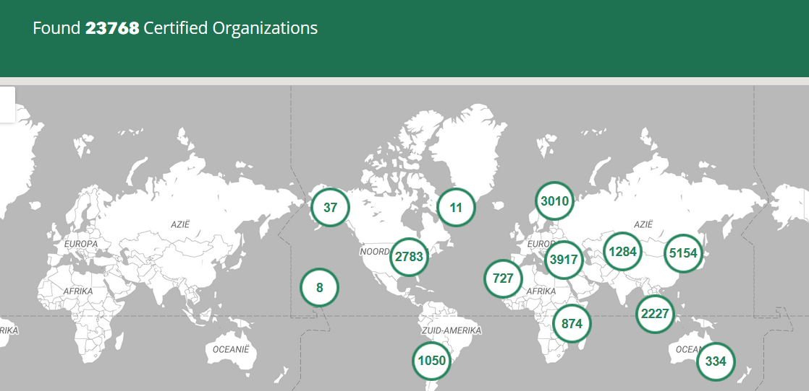
FSSC

Slide 78
What is FSSC 22000 based on?
ISO 22000:2018
Sector specific Pre-Requisite Program (PRP) ISO/TS 22002
Specific FSSC 22000 requirements
The FSSC 22000 standard is a food safety management system that focuses on the PDCA approach
Both at the organizational level and at the operational level
Focus on risk-based thinking and in the field of HACCP

Slide 79
ISO22000: standard requirements
4 Context of the organization
5 Leadership
6 Planning
7 Support
8 Operation
9 Performance evaluation
10 Improvement

Slide 80
ISO/TS 22002 15 standard requirements
4 Construction and layout of buildings
5 Layout of premises and workspace
6 Utilities – air, water, energy
7 Waste disposal
8 Equipment suitability, cleaning and maintenance
9 Management of purchased materials
10 Measures for prevention of cross contamination

Slide 81
ISO/TS 22002 15 standard requirements
11 Cleaning and sanitizing
12 Pest control
13 Personnel hygiene and employee facilities
14 Rework
15 Product recall procedures
16 Warehousing
17 Product information/consumer awareness
18 Food defense, biovigilance and bioterrorism
FSSC 22000 does not work with scores on the certificate. There is, however, a three-year cycle in which one unannounced audit is compulsory in those three years.

Slide 82
FSSC22000 audits
Do not forget the appendix: extra standard requirements (nice surprise during an audit if these are not explained in the cross table)
FSSC 22000 does not work with scores on the certificate. There is, however, a three-year cycle in which one unannounced audit is compulsory in those three years.
Use PAS 96 for Food Defense

Slide 83
Other standards relative to FSSC 22000
The big difference between FSSC 22000 and, for example, the BRC and IFS, is that there is no checklist stating exactly what is and what is not accepted (as is the case with BRC/IFS)
The FSSC 22000 standards leaves more room for interpretation and personal insight. This is both an advantage and disadvantage.
Certain risks can be excluded by means of well-founded arguments in the HACCP-analysis. In this way, a practical and workable system can be created for every company.

Slide 84
Contents
Food Safety Compliance
FSSC22000
What should you pay attention to?
FSSC22000, version 5 HLS
QESH standards
HACCP team: tasks
HACCP team: annual reports
Notes:
84

Slide 85
What should you pay attention to?
Do not forget Appendix FSSC, including services
Knock Outs at IFS
Fundamentals at BRC
Management board expectation:
  80% of audit results dependent on the auditor
  Focus with QA on a working system AND do not use the standard as an improvement tool.
  BRC and IFS are often a settlement instrument, make sure that everything is correct on the days of the audit and that open action points that are standard related are also resolved.
  Enough QA managers and advisors can wrongly do something else after an undesired score.

Slide 86
What should you at least arrange properly?
Food Production parameters
  Product: product assurance & development
  Process : Cleaning and disinfection
  Person: screening for diseases and hygienic working
  Production area
Food Defense
Food Fraud
Evidence Based practice:
Evidence: everything done for food safety
Make sure all data is stored in the company! Code microbiology so that you don’t fall victim to external errors.
Plant Based chilled // ready to heat
Notes:
86

Slide 87
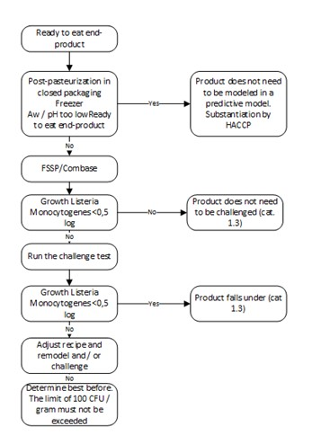
What should you at least arrange properly?
Make sure everyone knows the location of:
  HACCP study
  Management reports
  Listeria and additives overview
Train relevant colleagues in
  The management system
  HACCP
  Internal auditing
  Location information sources
  Traceability
  ERP system and Backups
Use a separate system for consumer & chain information
Notes:
87

Slide 88
Contents
Food Safety Compliance
FSSC22000
What should you pay attention to?
FSSC22000, version 5 HLS
QESH standards
HACCP team: tasks
HACCP team: annual reports
Notes:
88

Slide 89
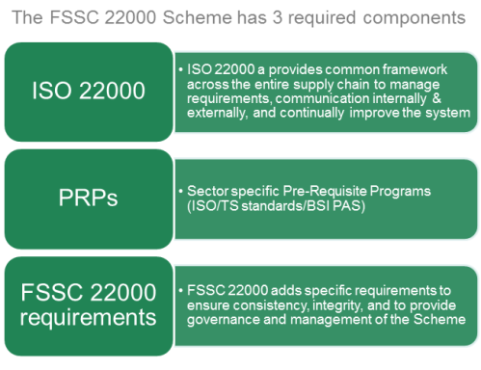
FSSC22000 version 5: general
Notes:
89

Slide 90
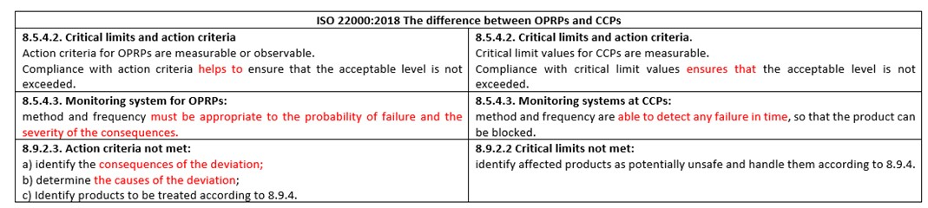
FSSC22000 version 5: general
Notes:
90

Slide 91
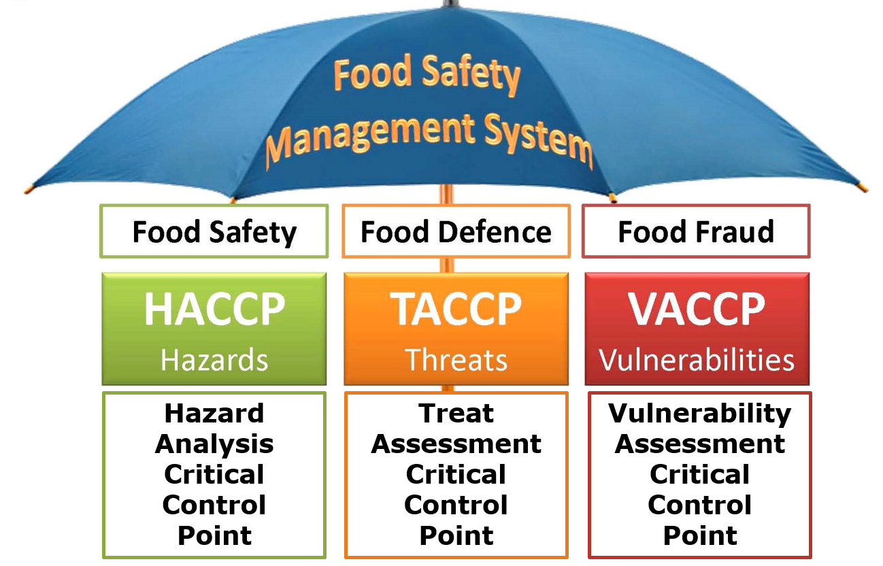
FSSC22000 version 5: general
iMIS Food: procedures for Food Defense and Food Fraud
TACCP and VACCP reports based on FSSC guidelines
Notes:
91

Slide 92
10 clause structure - Main clauses of High Level Structure (HLS)
01
Scope
06
Planning
02
Normative references
07
Support
FSSC22000 version 5: ISO22000 changes
03
Terms and definitions
08
Operation
04
Context of the organization
09
Performance evaluation
05
Leadership
10
Improvement
Notes:
Core clauses are the same with other standards(HLS), but in 08 operation changes
92

Slide 93
FSSC22000 version 5: ISO22000 changes
Organizational planning and control
Risk on 2 levels
Strategic
Company risks
Management is leading
Operational
HACCP
QA is leading
PLAN (FSMS)
4. Context of the organization
5. Leadership
6. Planning
7. Support*
DO (FSMS)
8. Operation
CHECK (FSMS)
9. Performance evaluation
ACT (FSMS)
10. Improvement
Operational planning and control
PRPs
Hazard analysis
Validation of control measures
Hazard contol plan (HACCP/oPRP plan)
Verification planning
Traceability system
Emergency preparedness & response
PLAN (food safety)
Updating of preliminary information and documents specifying the PRPs and the hazard control plan
Verification activities
Implementation of the PLAN (food safety)
Analysis of results of verification activities
Control of monitoring and measuring
Control of products & process nonconformities
ACT (food safety)
CHECK (food safety)
DO (food safety)
Notes:
93

Slide 94
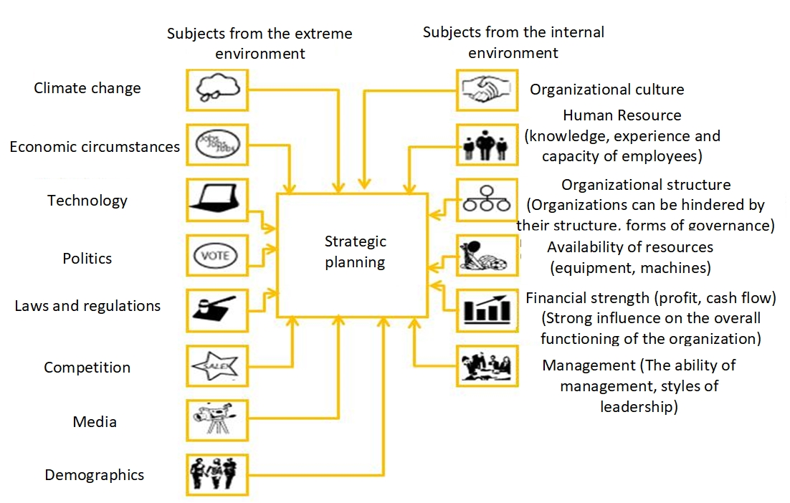
FSSC22000 version 5: Context analysis and SWOT
Notes:
94

Slide 95
6.1 Actions to address risks and opportunities
FSSC22000 version 5: Context analysis and SWOT
When planning for the food safety management system, the organization should consider the topics listed in 4.1 and the requirements listed in 4.2, and identify the risks and opportunities that need to be addressed to:
To ensure that the food safety management system achieves its intended result;
Prevent or reduce unwanted effects;
Achieve continuous improvement.
The organization must:
Plan actions to address these risks and opportunities
Plan in which way:
The measures are integrated and implemented in its food safety management system processes;
The effectiveness of these measures should be evaluated.
Notes:
95

Slide 96
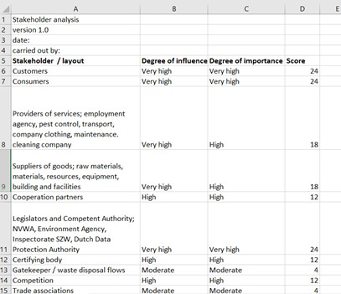
FSSC22000 version 5: Context analysis and SWOT

Slide 97
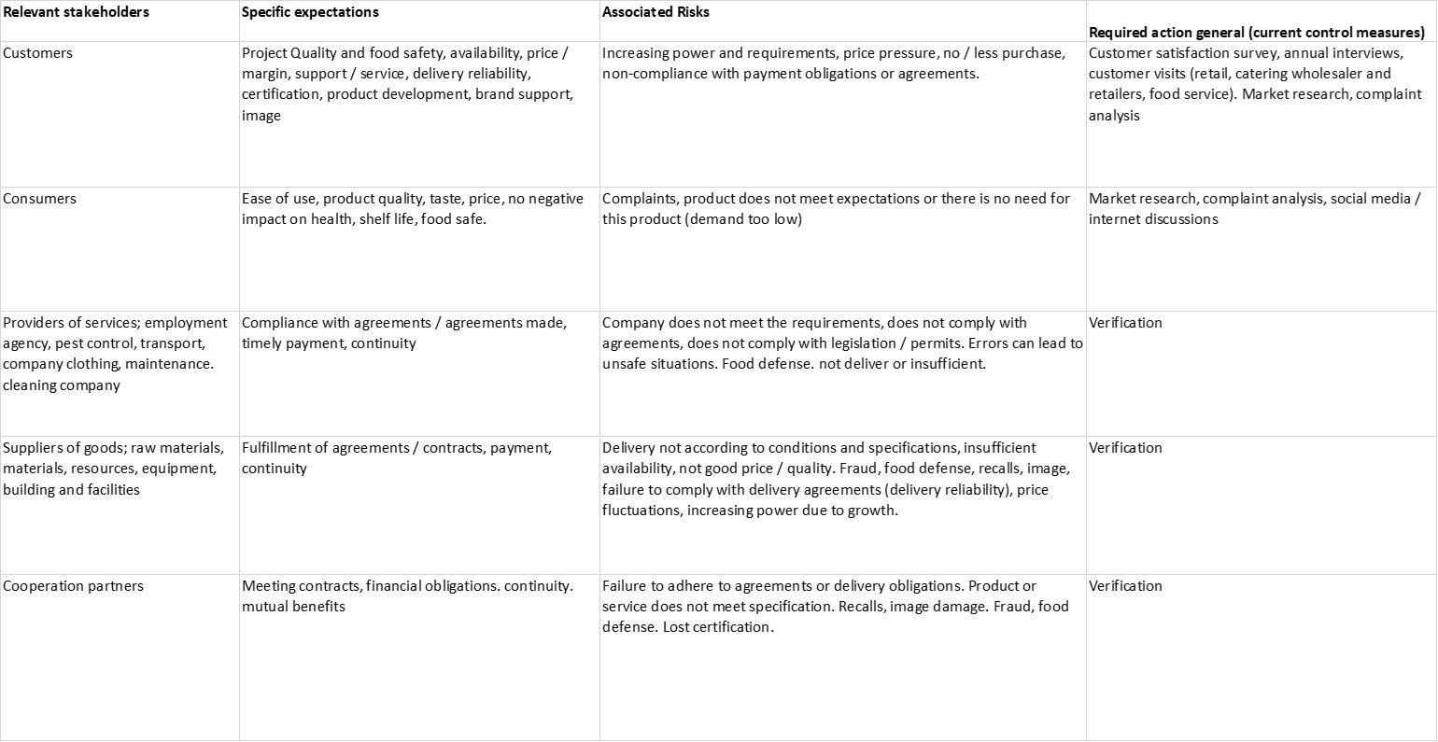
FSSC22000 version 5: Context analysis and SWOT
Step 1 Determining stakeholder: all stakeholders with a score of 8 or higher are considered relevant
Step 2 Determining expectation from a stakeholder’s point of view

Slide 98
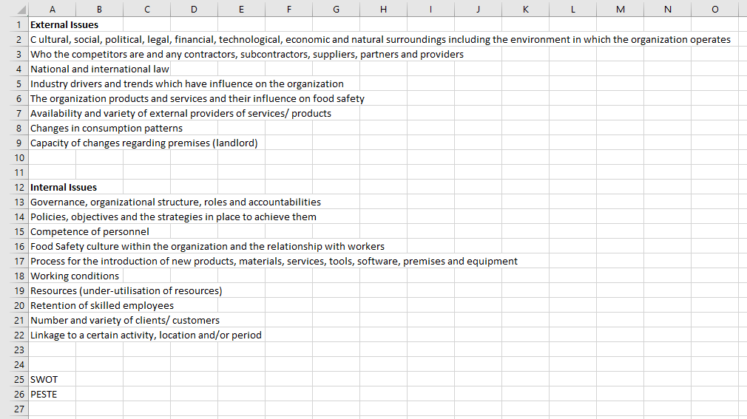
FSSC22000 version 5: Context analysis and SWOT
Step 1 Determining stakeholder: all stakeholders with a score of 8 or higher are considered relevant
Step 2 Determining expectation from a stakeholder’s point of view
Step 3 Risk analysis: internal and external issues

Slide 99
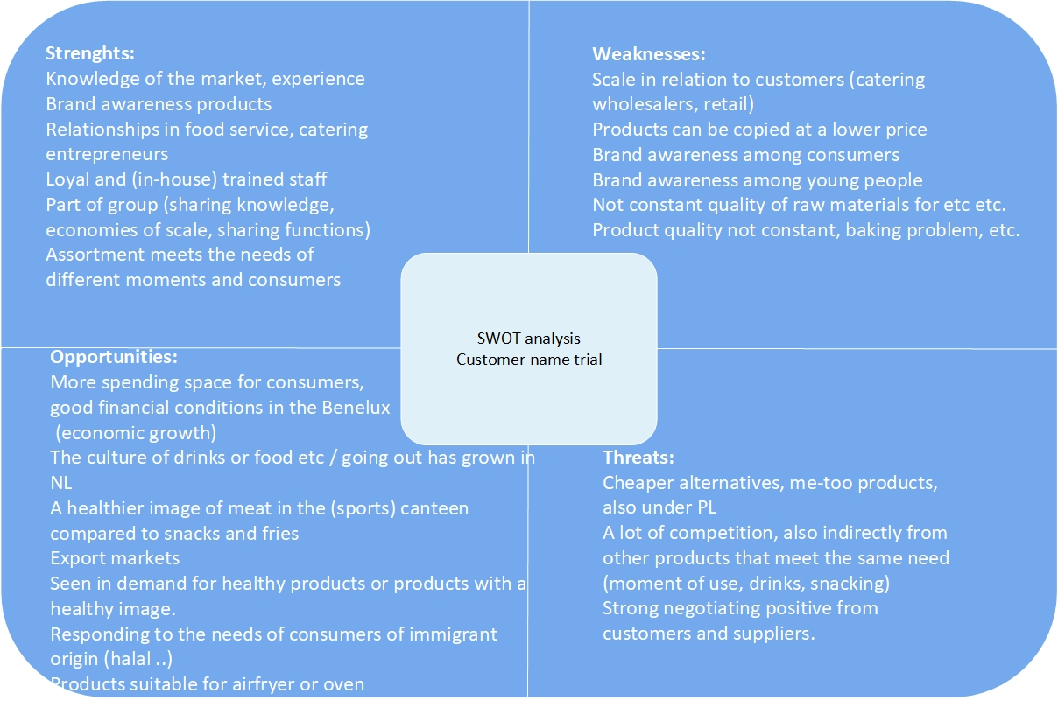
FSSC22000 version 5: Context analysis and SWOT

Slide 100
Our company
How is our context analysis, stakeholder analysis and SWOT?
  Same for the TACCP and VACCP study
  How is our procedure for Food Defense and Food Fraud?

Slide 101
Contents
Food Safety Compliance
FSSC22000
What should you pay attention to?
FSSC22000, version 5 HLS
QESH standards
HACCP team: tasks
HACCP team: annual reports
Notes:
101

Slide 102
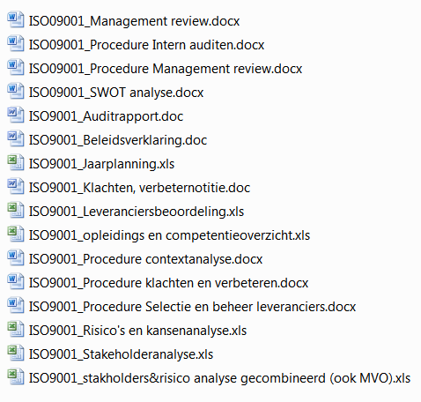
IS09001

Slide 103
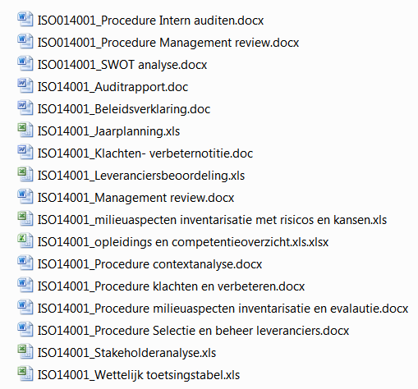
ISO14001

Slide 104
Contents
Food Safety Compliance
FSSC22000
What should you pay attention to?
FSSC22000, version 5 HLS
QESH standards
HACCP team: tasks
HACCP team: annual reports
Notes:
104

Slide 105
HACCP team: tasks (1/2)
The HACCP team has the following responsibilities:
  Conduct a hazard analysis to determine which hazards need to be controlled, which degree of control is required to achieve food safety and what combination of control measures is required.
  Plan and implement processes necessary for the validation of control measures and/or combinations of control measures, and to improve the food safety management system verification and improvement.
  Assess changes in the production process that have a negative effect on the food safety.
  Verification of the food safety system.
  Indicate per process step, including all products, all processes and all elements of the PRP on which these have been assessed and justify whether it is a Critical Control Point (CCP or OPRP).
  Check whether the food safety system falls within the scope and whether the scope covers the entire food safety system.
  Make adjustments to keep the food safety system up to date and correct either by verification or validation.

Slide 106
HACCP team: tasks (2/2)
Management of training courses for staff to ensure that everyone has sufficient knowledge related to the necessary food safety.
Determining and verifying the scope.
In case of changes in raw materials, packaging materials, processing methods, infrastructure and/or equipment, the HACCP plan is revised to ensure that the product safety requirements are met.
In the hazard analysis, attention is also paid to the position in the chain and will be taken into account with our suppliers and customers.
It is essential that the HACCP team has sufficient expertise. The expertise and composition of the HACCP team is recorded in the HACCP team TBV overview. Due to the current composition of the HACCP team, all necessary knowledge and expertise is available for the daily course of events. For additional specific information, QAssurance B.V. is used.
The HACCP team has the approval of the management and is supported where possible with
the necessary resources, facilities and time.

Slide 107
HACCP meetings
An HACCP team consultation takes place according to a fixed frequency in which it is at least assessed whether:
  The food safety system is up-to-date and effective.
  The measures taken have been adequately implemented/taken.
  New processes and/or products must be or have been assessed.
  Developments with regard to legislation, technology, knowledge, etc. that have an impact on us.
  Incidents or new information regarding food fraud or food defense that affect us.
  Furthermore, any calamities and standard violations are reviewed and possible improvements identified. The realization of formulated objectives are assessed and the identified cause is investigated in the event of non-achievement of targets. Then the measures are defined.
  The meetings are reported.

Slide 108
HACCP team: input (including from directive)
New products;
New raw materials;
New excipients;
Recipe adjustments;
New or changed processes, investments;
New location of equipment or environment;
New suppliers of product or service, new services;
New customer requirements that need to be translated to the shop floor;
Changes in cleaning and disinfection (method, means, frequency, etc.);
Possible legal changes or changes in standards;
Changes in packaging and/or packaging material;
Changes in storage or transport;
Changes in the organisation, competences, responsibilities and authorities;
Complaints and alerts;
State of the art, new knowledge, research results;
New knowledge about food safety hazards and control measures;
Quality Level changes
Objectives.

Slide 109
Our company
Who is in the HACCP team why; and who is the HACCP team leader?
What are the latest HACCP procedures?
What were the latest changes in the company that have an impact on the study?
When was the last time validated?
What about the central action list and what is the next annual plan?

